Slide 1
Digital Representation of Analog Signals
Gaurav S. Kasbekar
Dept. of Electrical Engineering
IIT Bombay

Slide 2
Introduction
Recall: digital communication systems have several advantages over analog communication systems
former have replaced or are replacing latter in most contexts, e.g., cellular networks, TV
“Analog communication” and “digital communication”:
in practice, all communication is via continuous signals and hence analog in nature
the message signal that is to be transmitted is either analog or digital
E.g., if the source is speech, then:
In analog communication, it is directly used to modulate a high-frequency carrier signal
In digital communication, it is sampled and quantized to obtain a bit stream, which is then used to modulate a high-frequency carrier signal
First step in digital transmission of analog source (e.g., speech, music) is conversion of source to digital representation
We now study:
this analog to digital conversion
and representation of the analog information as a sequence of pulses

Slide 3
The Sampling Process
Sampling is used to convert an analog signal to sequence of samples that are usually spaced uniformly in time
Sampling rate must be chosen carefully, so that:
the sequence of samples uniquely defines the original analog signal
Sampling theorem tells us how to choose sampling rate
We now briefly review the sampling process and prove the sampling theorem

Slide 4
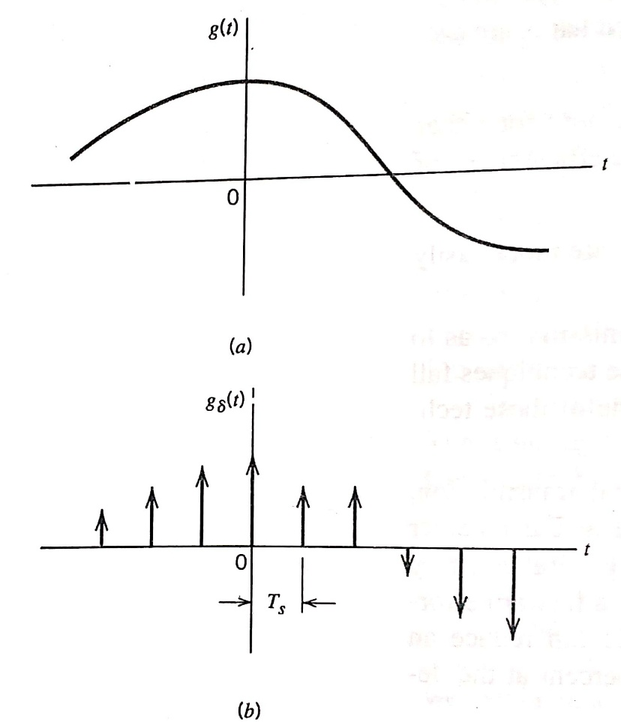
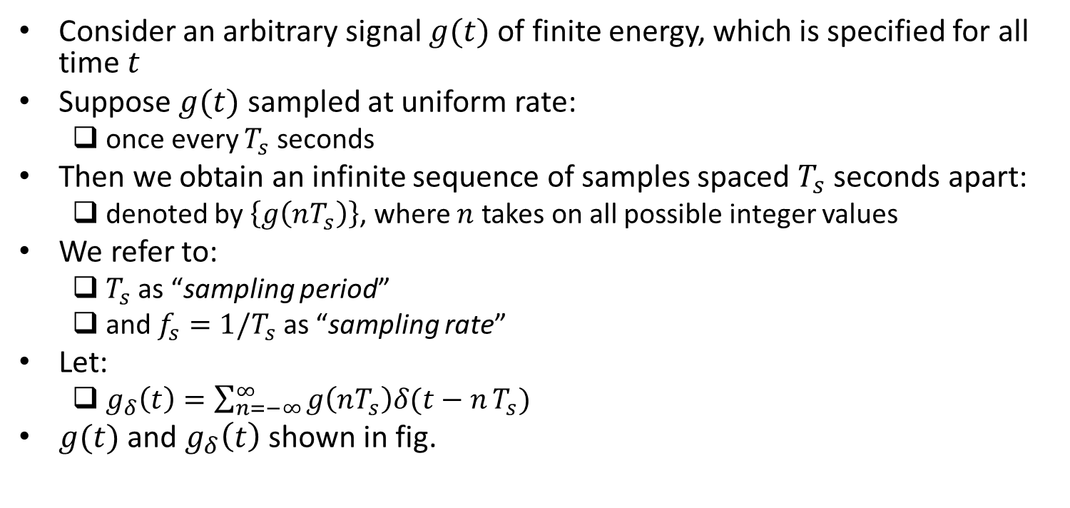
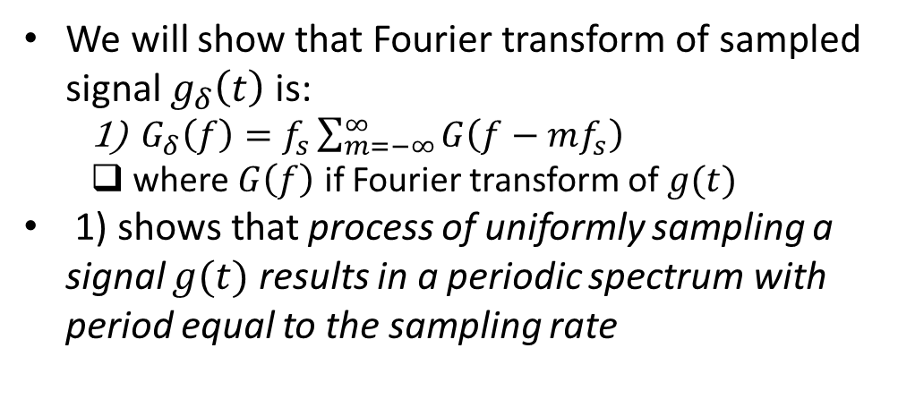
The Sampling Process (contd.)
Consider an arbitrary signal $g(t)$ of finite energy, which is specified for all time $t$
Suppose $g(t)$ sampled at uniform rate:
once every $T_{s}$ seconds
Then we obtain an infinite sequence of samples spaced $T_{s}$ seconds apart:
denoted by $\left\{g\left(nT_{s}\right)\right\}$, where $n$ takes on all possible integer values
We refer to:
$T_{s}$ as “sampling period”
and $f_{s}=1/T_{s}$ as “sampling rate”
Let:
$g_{δ}\left(t\right)=\sum_{n=−∞}^{∞}{g\left(nT_{s}\right)δ(t−n}T_{s})$
$g(t)$ and $g_{δ}\left(t\right)$ shown in fig.
We will show that Fourier transform of sampled signal $g_{δ}\left(t\right)$ is:
$G_{δ}\left(f\right)=f_{s}\sum_{m=−∞}^{∞}{G\left(f−mf_{s}\right)}$
where $G\left(f\right)$ if Fourier transform of $g(t)$
1) shows that process of uniformly sampling a signal $g(t)$ results in a periodic spectrum with period equal to the sampling rate
Ref: “Communication Systems” by Haykin and Moher, 5th ed

Slide 5
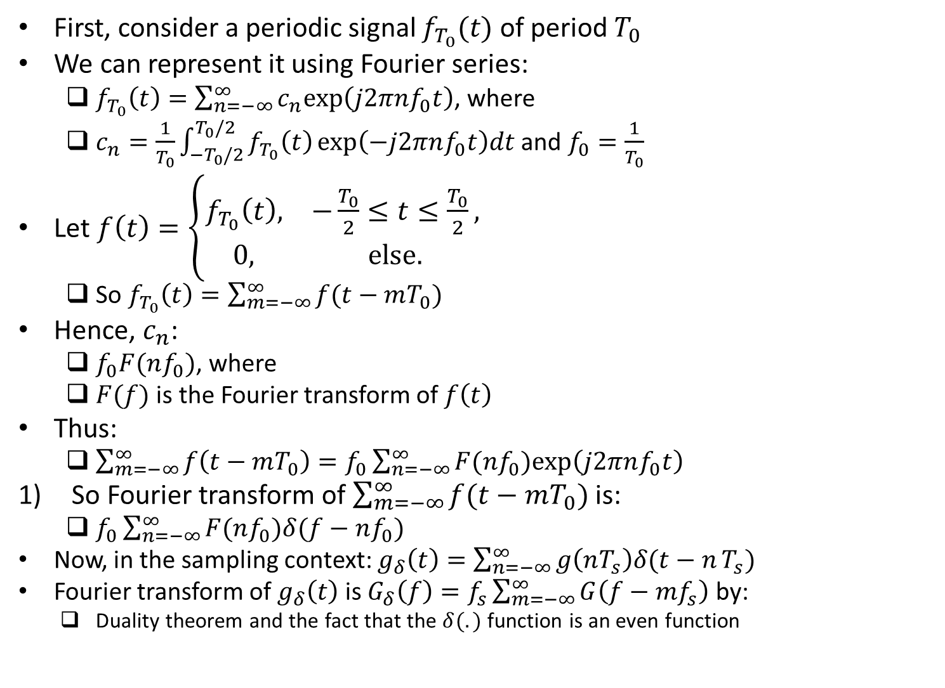
Proof of the Claim $G_{δ}\left(f\right)=f_{s}\sum_{m=−∞}^{∞}{G\left(f−mf_{s}\right)}$
First, consider a periodic signal $f_{T_{0}}(t)$ of period $T_{0}$
We can represent it using Fourier series:
$f_{T_{0}}\left(t\right)=\sum_{n=−∞}^{∞}{c_{n}exp\left(j2πnf_{0}t\right)}$, where
$c_{n}=\frac{1}{T_{0}}\int_{−T_{0}/2}^{T_{0}/2}{f_{T_{0}}\left(t\right)}exp\left(−j2πnf_{0}t\right)dt$ and $f_{0}=\frac{1}{T_{0}}$
Let $f\left(t\right)=\left\{\begin{matrix}f_{T_{0}}\left(t\right), & −\frac{T_{0}}{2}≤t≤\frac{T_{0}}{2}, \\ 0, & else.\end{matrix}\right.$
So $f_{T_{0}}\left(t\right)=\sum_{m=−∞}^{∞}{f(t−mT_{0})}$
Hence, $c_{n}$:
$f_{0}F(nf_{0})$, where
$F(f)$ is the Fourier transform of $f\left(t\right)$
Thus:
$\sum_{m=−∞}^{∞}{f\left(t−mT_{0}\right)=f_{0}\sum_{n=−∞}^{∞}{F(nf_{0})exp\left(j2πnf_{0}t\right)}}$
So Fourier transform of $\sum_{m=−∞}^{∞}{f(t−mT_{0})}$ is:
$f_{0}\sum_{n=−∞}^{∞}{F(nf_{0})δ(f−nf_{0}) }$
Now, in the sampling context: $g_{δ}\left(t\right)=\sum_{n=−∞}^{∞}{g\left(nT_{s}\right)δ(t−n}T_{s})$
Fourier transform of $g_{δ}\left(t\right)$ is $G_{δ}\left(f\right)=f_{s}\sum_{m=−∞}^{∞}{G\left(f−mf_{s}\right)}$ by:
Duality theorem and the fact that the $δ(.)$ function is an even function

Slide 6
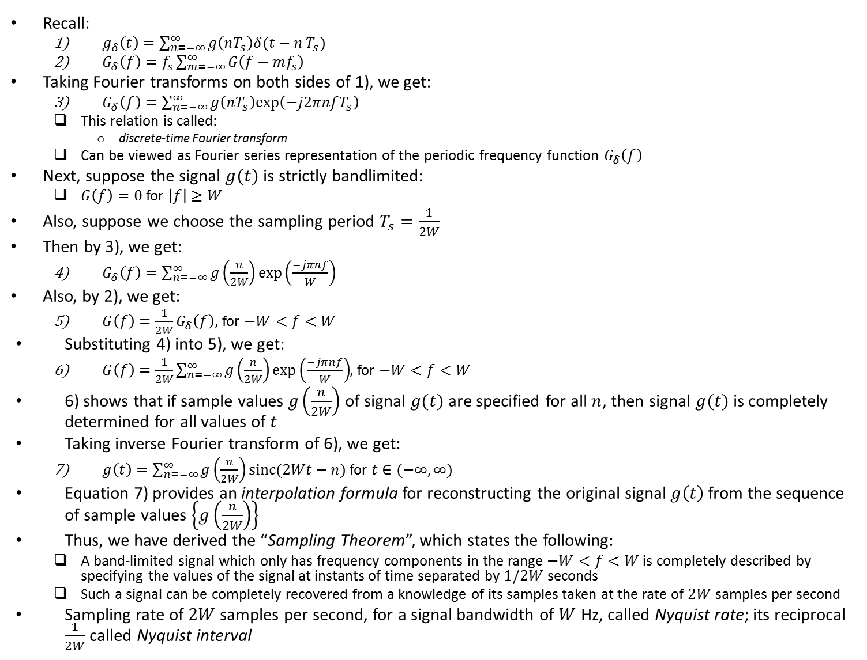
The Sampling Process (contd.)
Recall:
$g_{δ}\left(t\right)=\sum_{n=−∞}^{∞}{g\left(nT_{s}\right)δ(t−n}T_{s})$
$G_{δ}\left(f\right)=f_{s}\sum_{m=−∞}^{∞}{G\left(f−mf_{s}\right)}$
Taking Fourier transforms on both sides of 1), we get:
$G_{δ}\left(f\right)=\sum_{n=−∞}^{∞}{g\left(nT_{s}\right)exp\left(−j2πnfT_{s}\right)}$
This relation is called:
discrete-time Fourier transform
Can be viewed as Fourier series representation of the periodic frequency function $G_{δ}\left(f\right)$
Next, suppose the signal $g(t)$ is strictly bandlimited:
$G\left(f\right)=0$ for $\left|f\right|≥W$
Also, suppose we choose the sampling period $T_{s}=\frac{1}{2W}$
Then by 3), we get:
$G_{δ}\left(f\right)=\sum_{n=−∞}^{∞}{g\left(\frac{n}{2W}\right)exp\left(\frac{−jπnf}{W}\right)}$
Also, by 2), we get:
$G\left(f\right)=\frac{1}{2W}G_{δ}\left(f\right)$, for $−W<f<W$
Substituting 4) into 5), we get:
$G\left(f\right)=\frac{1}{2W}\sum_{n=−∞}^{∞}{g\left(\frac{n}{2W}\right)exp\left(\frac{−jπnf}{W}\right)}$, for $−W<f<W$
6) shows that if sample values $g\left(\frac{n}{2W}\right)$ of signal $g(t)$ are specified for all $n$, then signal $g(t)$ is completely determined for all values of $t$
Taking inverse Fourier transform of 6), we get:
$g\left(t\right)=\sum_{n=−∞}^{∞}{g\left(\frac{n}{2W}\right)sinc(2Wt−n)}$ for $t∈(−∞,∞)$
Equation 7) provides an interpolation formula for reconstructing the original signal $g\left(t\right)$ from the sequence of sample values $\left\{g\left(\frac{n}{2W}\right)\right\}$
Thus, we have derived the “Sampling Theorem”, which states the following:
A band-limited signal which only has frequency components in the range $−W<f<W$ is completely described by specifying the values of the signal at instants of time separated by $1/2W$ seconds
Such a signal can be completely recovered from a knowledge of its samples taken at the rate of $2W$ samples per second
Sampling rate of $2W$ samples per second, for a signal bandwidth of $W$ Hz, called Nyquist rate; its reciprocal $\frac{1}{2W}$ called Nyquist interval

Slide 7
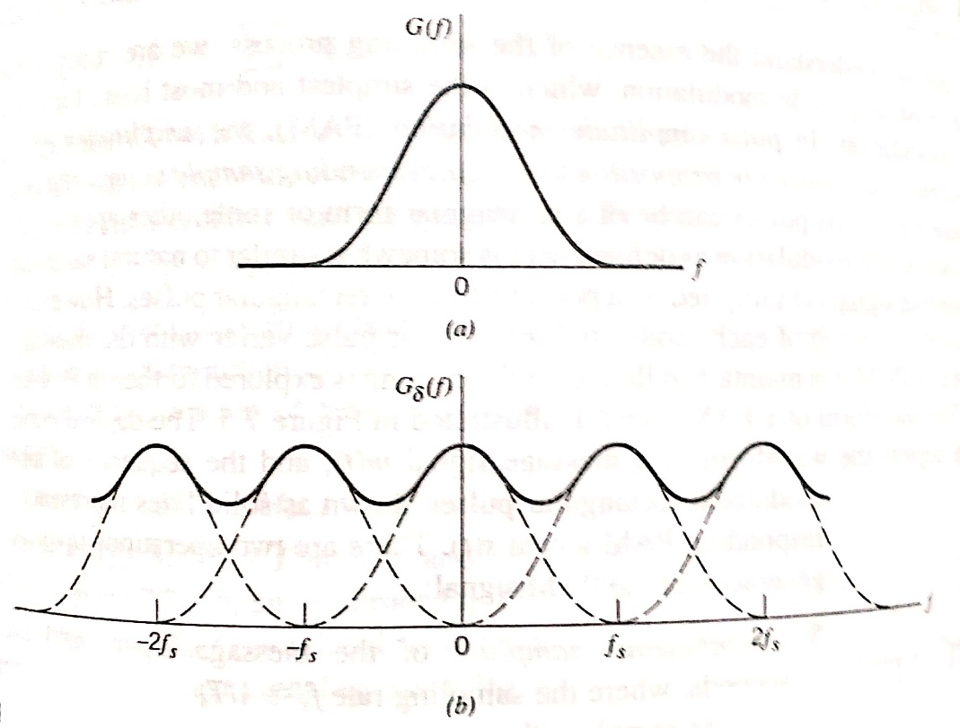
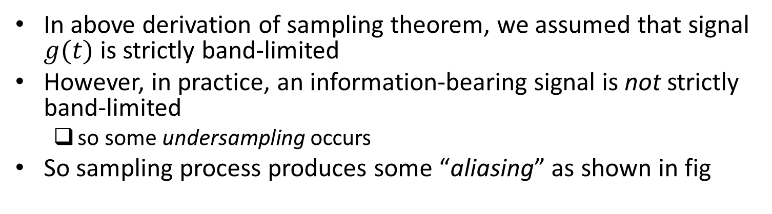
Aliasing
In above derivation of sampling theorem, we assumed that signal $g(t)$ is strictly band-limited
However, in practice, an information-bearing signal is not strictly band-limited
so some undersampling occurs
So sampling process produces some “aliasing” as shown in fig
To combat the effects of aliasing in practice:
Prior to sampling, a low-pass filter used to attenuate those high-frequency components that are not essential to information being conveyed by signal
Filtered signal is sampled at a rate slightly higher than Nyquist rate
Ref: “Communication Systems” by Haykin and Moher, 5th ed

Slide 8
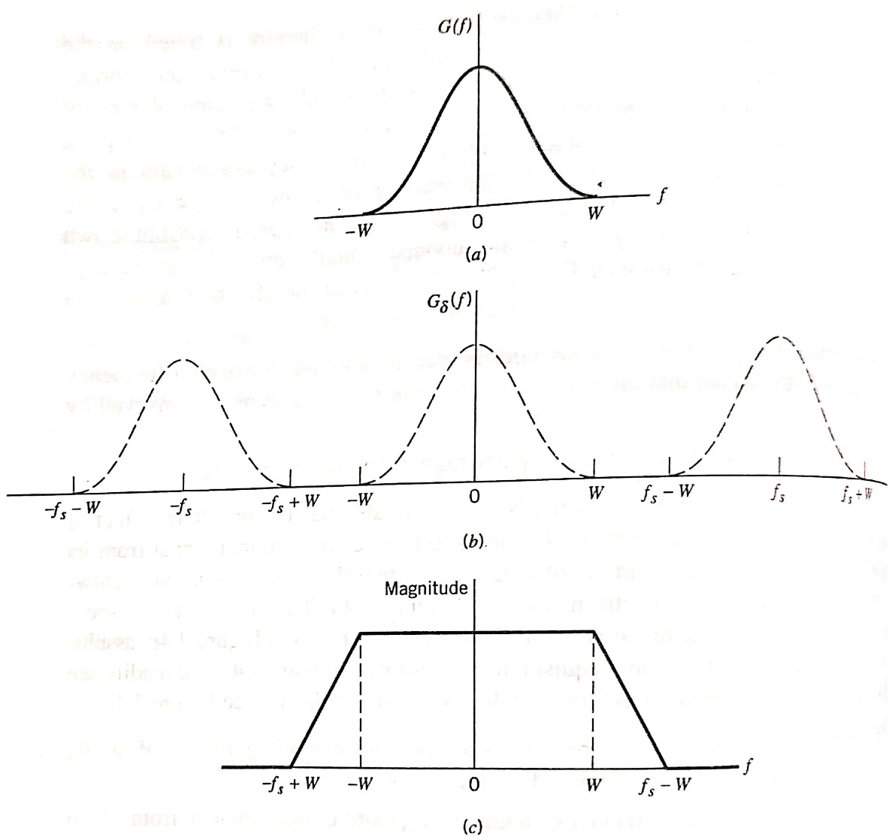
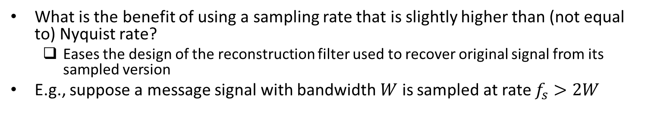
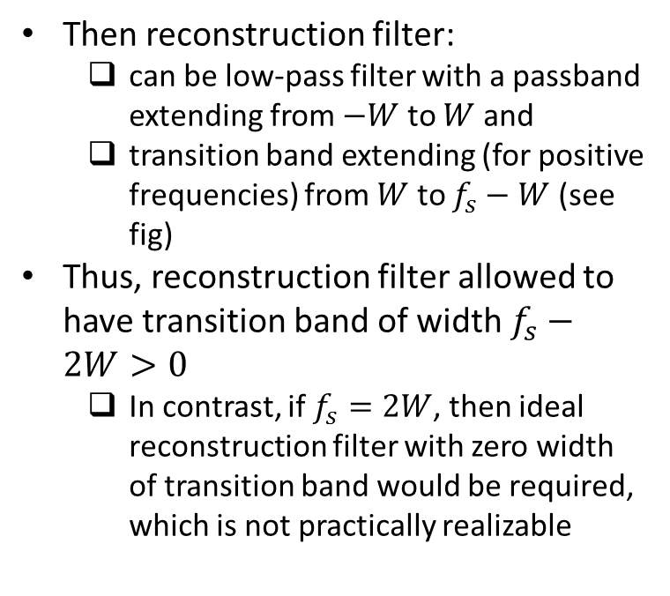
Aliasing (contd.)
What is the benefit of using a sampling rate that is slightly higher than (not equal to) Nyquist rate?
Eases the design of the reconstruction filter used to recover original signal from its sampled version
E.g., suppose a message signal with bandwidth $W$ is sampled at rate $f_{s}>2W$
Then reconstruction filter:
can be low-pass filter with a passband extending from $−W$ to $W$ and
transition band extending (for positive frequencies) from $W$ to $f_{s}−W$ (see fig)
Thus, reconstruction filter allowed to have transition band of width $f_{s}−2W>0$
In contrast, if $f_{s}=2W$, then ideal reconstruction filter with zero width of transition band would be required, which is not practically realizable
Ref: “Communication Systems” by Haykin and Moher, 5th ed

Slide 9
Practical Sampling
So far, we have considered ideal sampling using an impulse pulse train
But this sampling process is physically unrealizable
So next, we consider a practical implementation of sampling
Called “Pulse Amplitude Modulation”

Slide 10
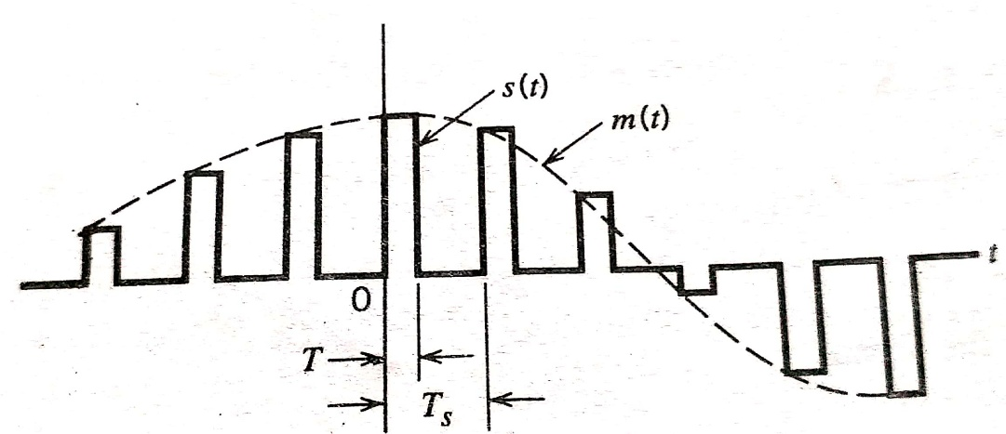
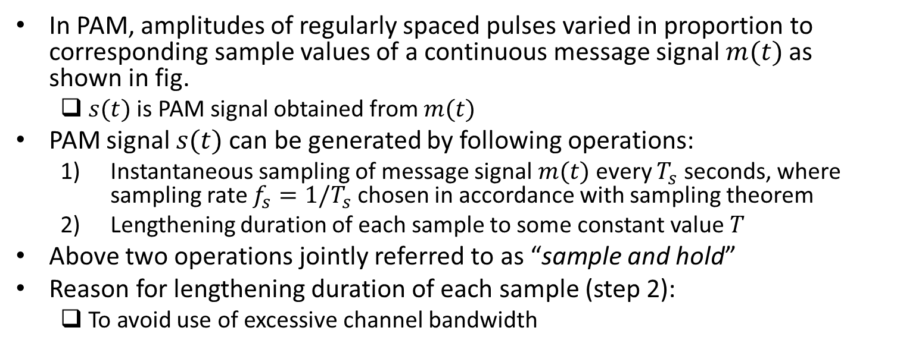
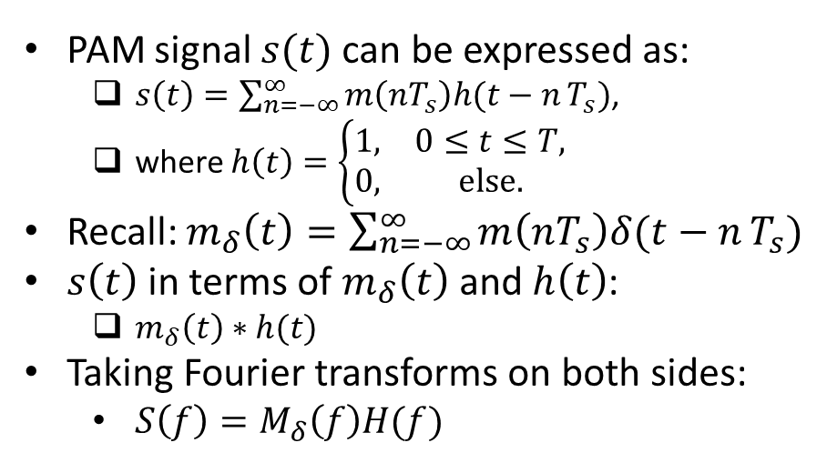
Pulse Amplitude Modulation (PAM)
In PAM, amplitudes of regularly spaced pulses varied in proportion to corresponding sample values of a continuous message signal $m(t)$ as shown in fig.
$s(t)$ is PAM signal obtained from $m(t)$
PAM signal $s(t)$ can be generated by following operations:
Instantaneous sampling of message signal $m(t)$ every $T_{s}$ seconds, where sampling rate $f_{s}=1/T_{s}$ chosen in accordance with sampling theorem
Lengthening duration of each sample to some constant value $T$
Above two operations jointly referred to as “sample and hold”
Reason for lengthening duration of each sample (step 2):
To avoid use of excessive channel bandwidth
PAM signal $s(t)$ can be expressed as:
$s\left(t\right)=\sum_{n=−∞}^{∞}{m\left(nT_{s}\right)h(t−n}T_{s})$,
where $h\left(t\right)=\left\{\begin{matrix}1, & 0≤t≤T, \\ 0, & else.\end{matrix}\right.$
Recall: $m_{δ}\left(t\right)=\sum_{n=−∞}^{∞}{m\left(nT_{s}\right)δ(t−n}T_{s})$
$s\left(t\right)$ in terms of $m_{δ}\left(t\right)$ and $h\left(t\right)$:
$m_{δ}\left(t\right)∗h(t)$
Taking Fourier transforms on both sides:
$S\left(f\right)=M_{δ}\left(f\right)H(f)$
Ref: “Communication Systems” by Haykin and Moher, 5th ed

Slide 11
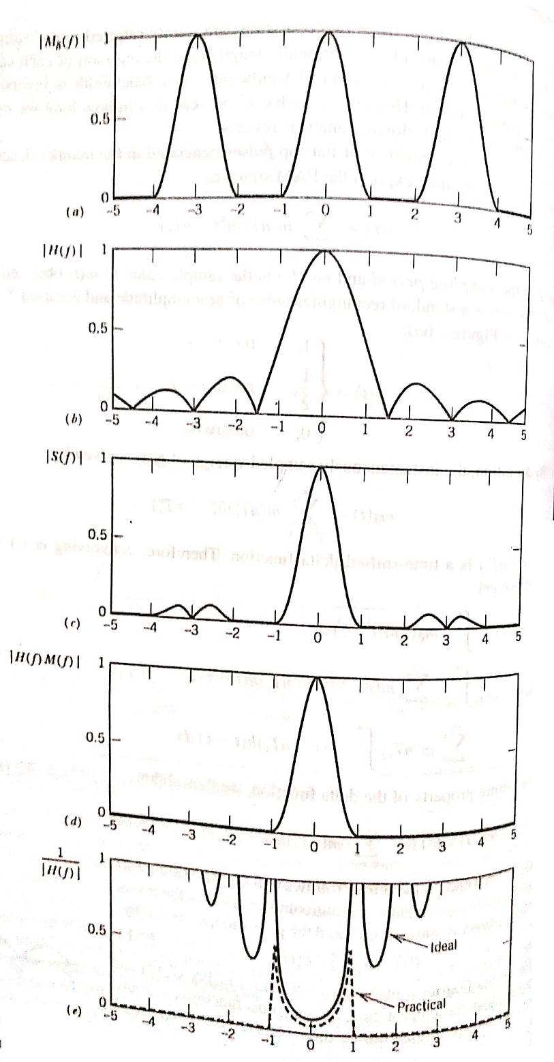
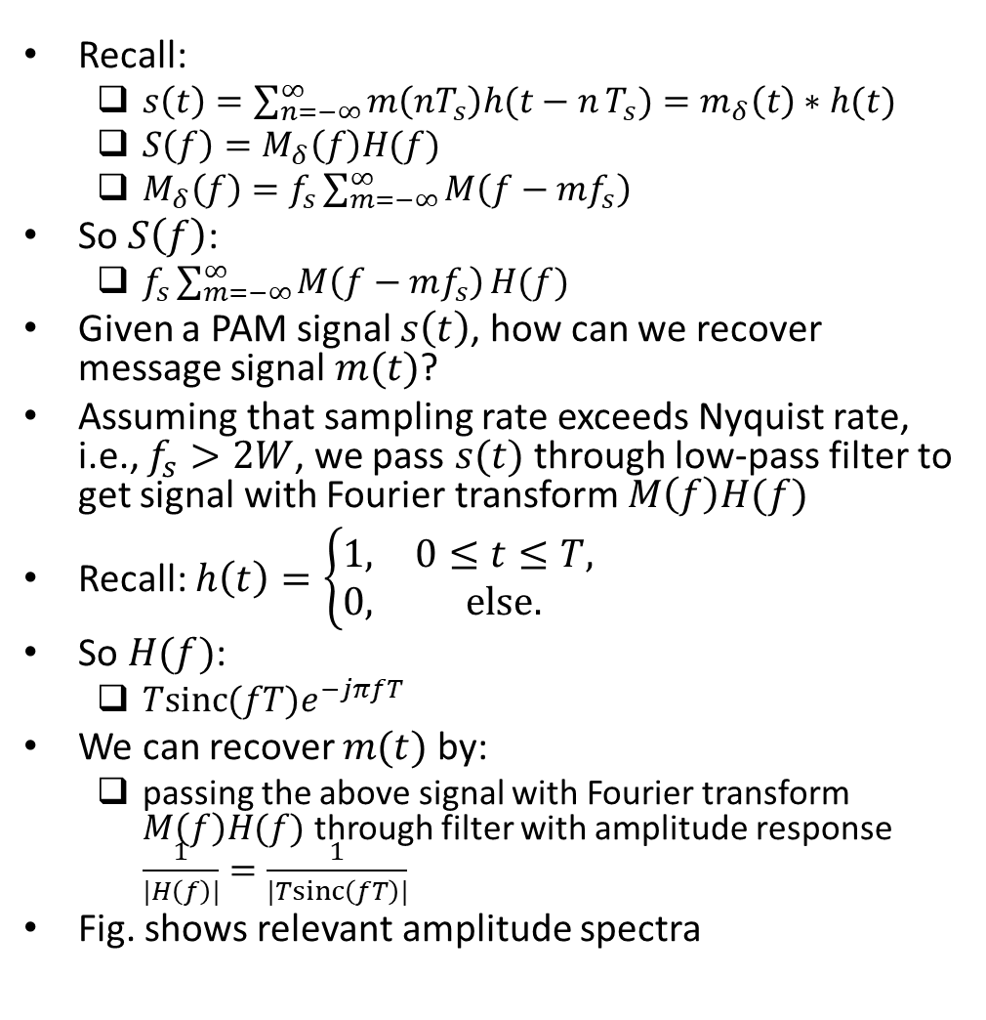
Pulse Amplitude Modulation (PAM) (contd.)
Recall:
$s\left(t\right)=\sum_{n=−∞}^{∞}{m\left(nT_{s}\right)h(t−n}T_{s})=m_{δ}\left(t\right)∗h(t)$
$S\left(f\right)=M_{δ}\left(f\right)H(f)$
$M_{δ}\left(f\right)=f_{s}\sum_{m=−∞}^{∞}{M\left(f−mf_{s}\right)}$
So $S\left(f\right)$:
$f_{s}\sum_{m=−∞}^{∞}{M\left(f−mf_{s}\right)}H(f)$
Given a PAM signal $s\left(t\right)$, how can we recover message signal $m(t)$?
Assuming that sampling rate exceeds Nyquist rate, i.e., $f_{s}>2W$, we pass $s(t)$ through low-pass filter to get signal with Fourier transform $M\left(f\right)H(f)$
Recall: $h\left(t\right)=\left\{\begin{matrix}1, & 0≤t≤T, \\ 0, & else.\end{matrix}\right.$
So $H(f)$:
$Tsinc(fT)e^{−jπfT}$
We can recover $m(t)$ by:
passing the above signal with Fourier transform $M\left(f\right)H(f)$ through filter with amplitude response $\frac{1}{|H\left(f\right)|}=\frac{1}{|Tsinc\left(fT\right)|}$
Fig. shows relevant amplitude spectra
Ref: “Communication Systems” by Haykin and Moher, 5th ed

Slide 12
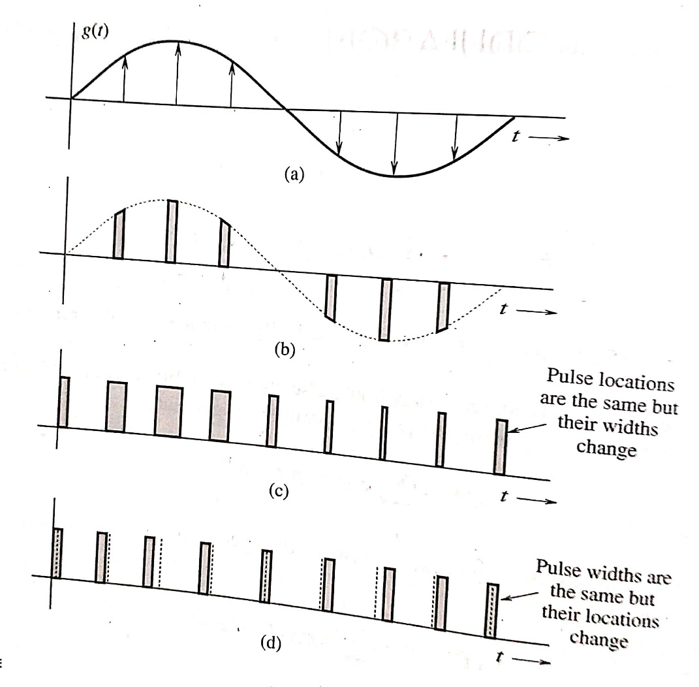
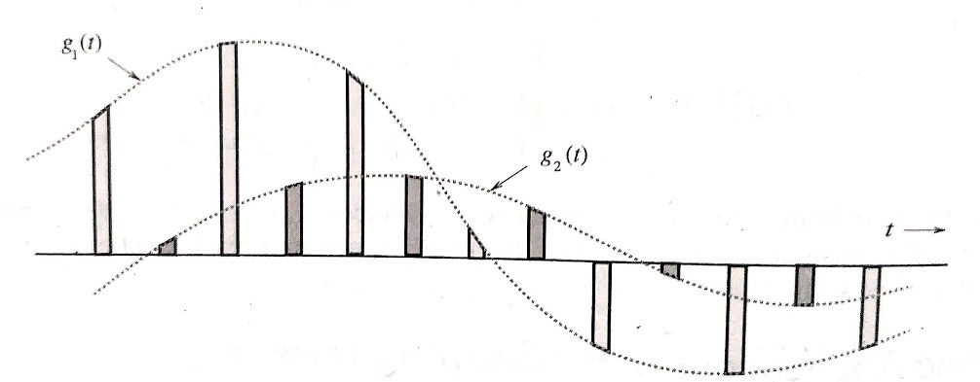
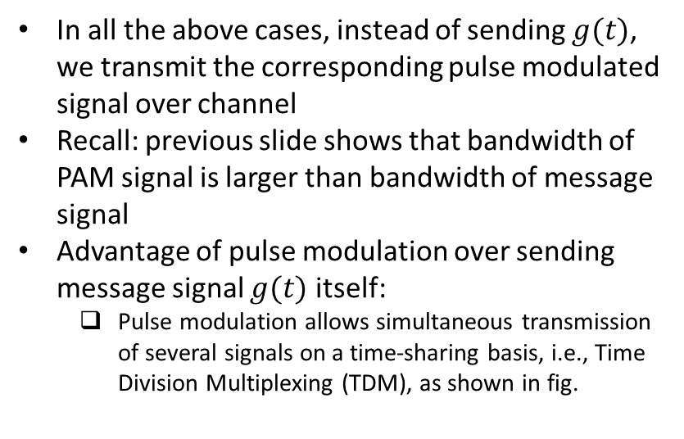
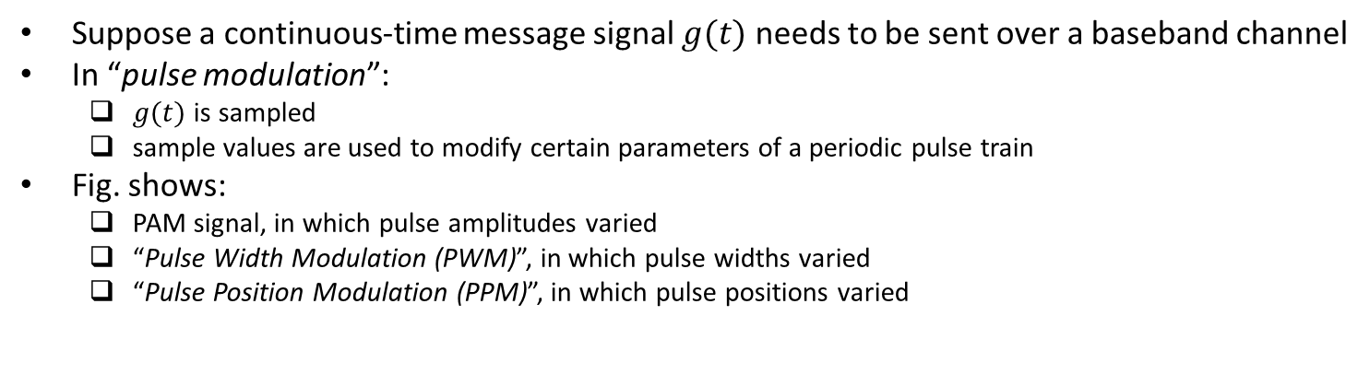
Communication Using Pulse Modulation
Suppose a continuous-time message signal $g(t)$ needs to be sent over a baseband channel
In “pulse modulation”:
$g(t)$ is sampled
sample values are used to modify certain parameters of a periodic pulse train
Fig. shows:
PAM signal, in which pulse amplitudes varied
“Pulse Width Modulation (PWM)”, in which pulse widths varied
“Pulse Position Modulation (PPM)”, in which pulse positions varied
In all the above cases, instead of sending $g(t)$, we transmit the corresponding pulse modulated signal over channel
Recall: previous slide shows that bandwidth of PAM signal is larger than bandwidth of message signal
Advantage of pulse modulation over sending message signal $g(t)$ itself:
Pulse modulation allows simultaneous transmission of several signals on a time-sharing basis, i.e., Time Division Multiplexing (TDM), as shown in fig.
Ref: “Modern Digital and Analog Comm. Systems” by B.P. Lathi and Z. Ding, 4th ed

Slide 13
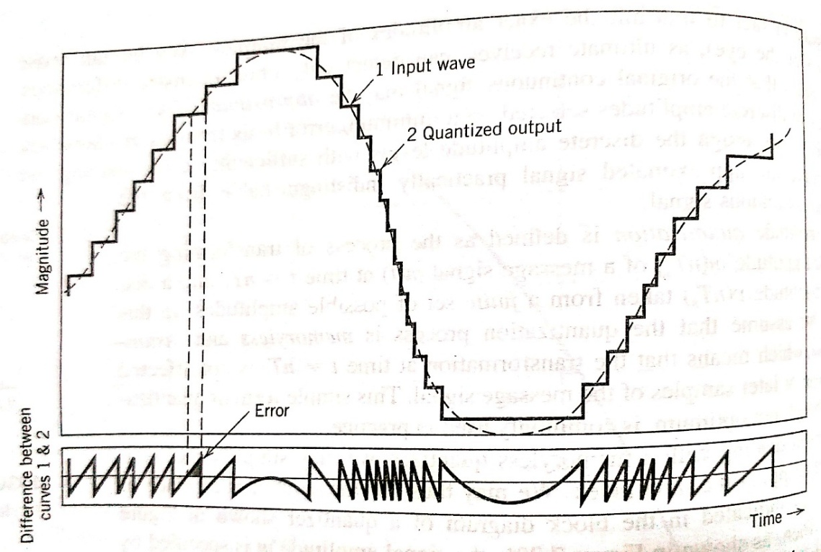
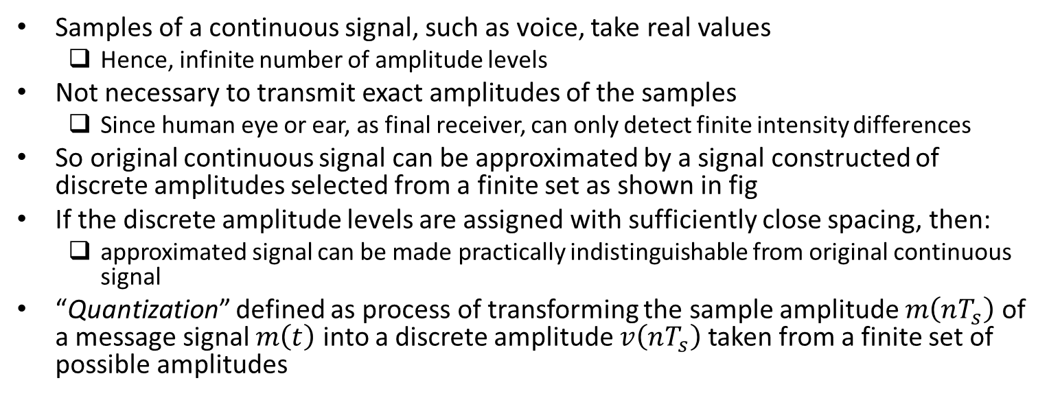
Quantization
Samples of a continuous signal, such as voice, take real values
Hence, infinite number of amplitude levels
Not necessary to transmit exact amplitudes of the samples
Since human eye or ear, as final receiver, can only detect finite intensity differences
So original continuous signal can be approximated by a signal constructed of discrete amplitudes selected from a finite set as shown in fig
If the discrete amplitude levels are assigned with sufficiently close spacing, then:
approximated signal can be made practically indistinguishable from original continuous signal
“Quantization” defined as process of transforming the sample amplitude $m\left(nT_{s}\right)$ of a message signal $m\left(t\right)$ into a discrete amplitude $v\left(nT_{s}\right)$ taken from a finite set of possible amplitudes
When digital communication used to transmit an analog message source (e.g., voice), then:
After sampling, message signal is quantized and then converted into a sequence of bits
Ref: “Communication Systems” by Haykin and Moher, 5th ed

Slide 14
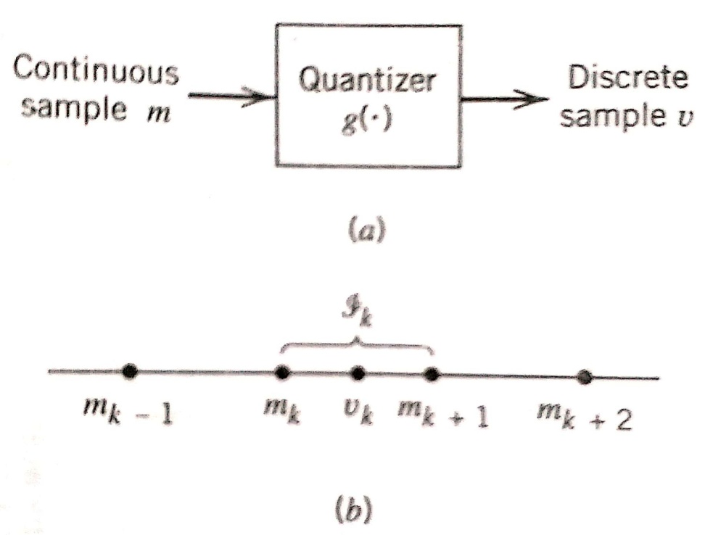
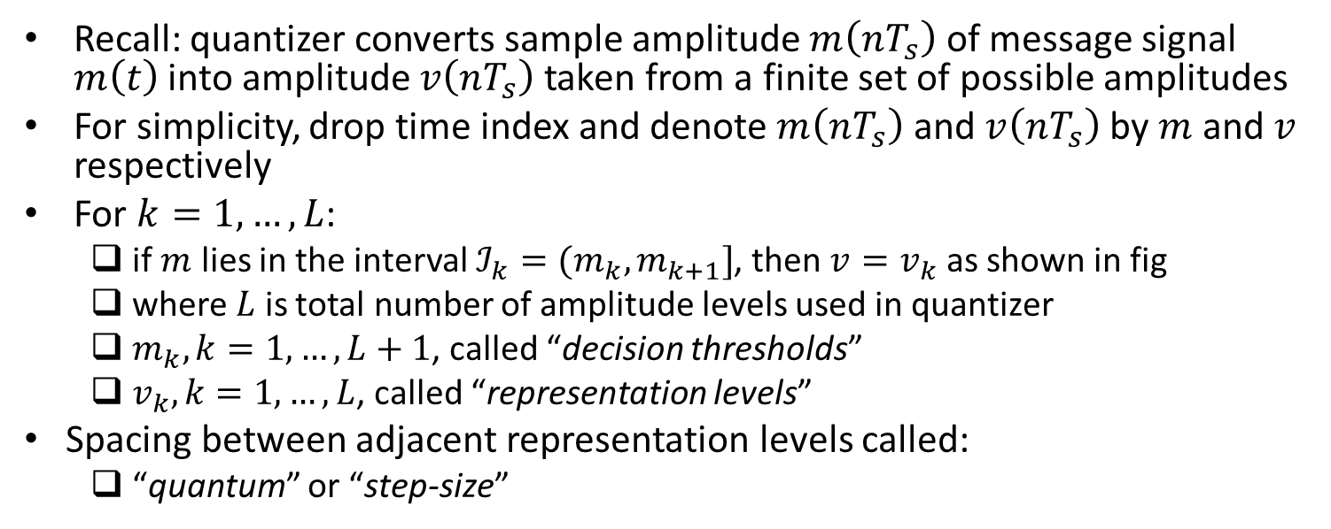
Quantization (contd.)
Recall: quantizer converts sample amplitude $m\left(nT_{s}\right)$ of message signal $m\left(t\right)$ into amplitude $v\left(nT_{s}\right)$ taken from a finite set of possible amplitudes
For simplicity, drop time index and denote $m\left(nT_{s}\right)$ and $v\left(nT_{s}\right)$ by $m$ and $v$ respectively
For $k=1,…,L$:
if $m$ lies in the interval $ℐ_{k}=(m_{k},m_{k+1}]$, then $v=v_{k}$ as shown in fig
where $L$ is total number of amplitude levels used in quantizer
$m_{k},k=1,…,L+1$, called “decision thresholds”
$v_{k},k=1,…,L$, called “representation levels”
Spacing between adjacent representation levels called:
“quantum” or “step-size”
Quantizers can be of a uniform or non-uniform type:
in uniform quantizer, representation levels are uniformly spaced and in non-uniform quantizer, they are not
We first discuss uniform quantizers and then non-uniform quantizers
Ref: “Communication Systems” by Haykin and Moher, 5th ed

Slide 15
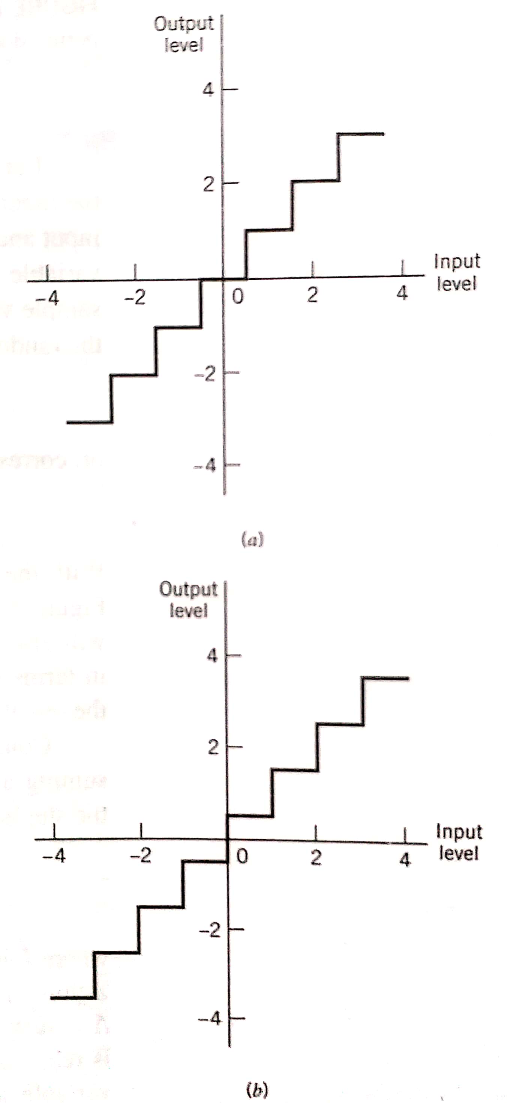
Quantization (contd.)
Quantizer characteristic can be of following types (see fig.):
“midtread type”: origin lies in middle of a tread of the staircase graph
“midrise type”: origin lies in middle of a rising part of the staircase graph
Ref: “Communication Systems” by Haykin and Moher, 5th ed

Slide 16
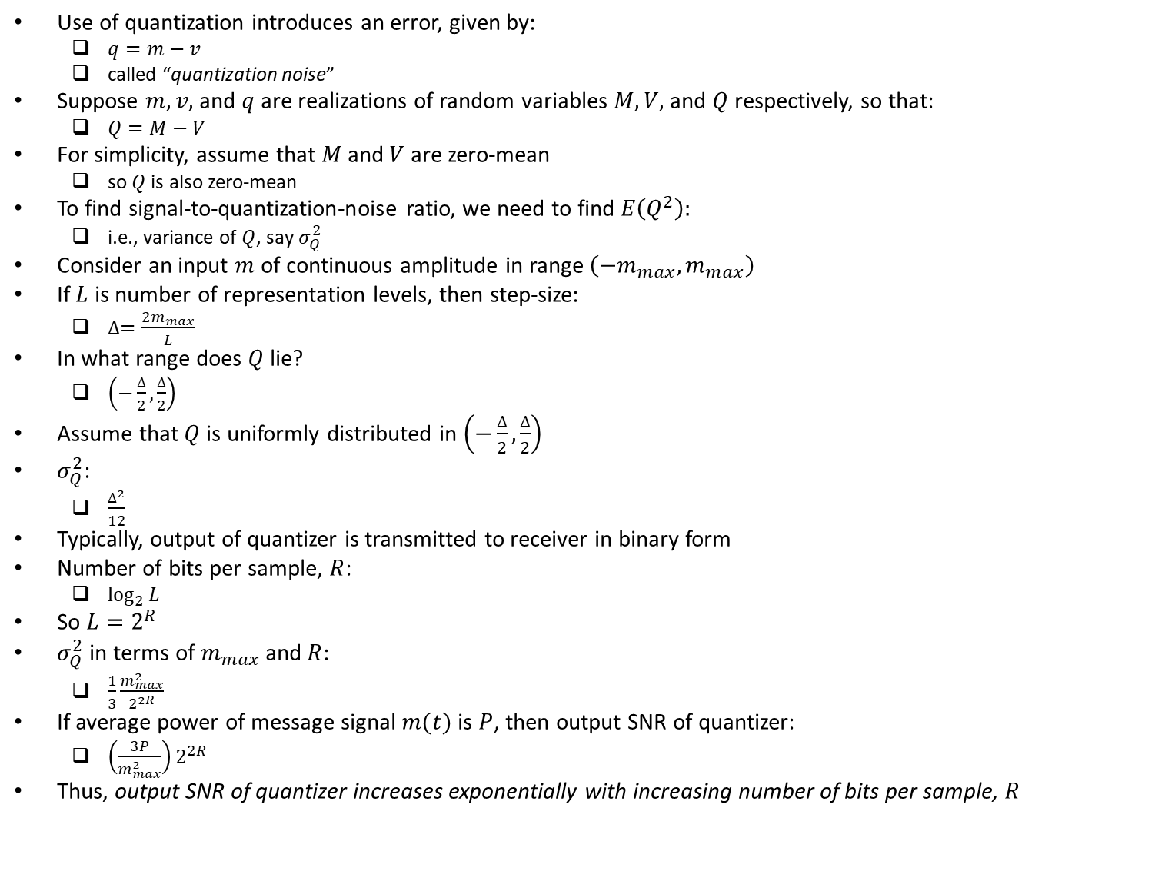
Quantization Noise
Use of quantization introduces an error, given by:
$q=m−v$
called “quantization noise”
Suppose $m, v,$ and $q$ are realizations of random variables $M, V,$ and $Q$ respectively, so that:
$Q=M−V$
For simplicity, assume that $M$ and $V$ are zero-mean
so $Q$ is also zero-mean
To find signal-to-quantization-noise ratio, we need to find $E\left(Q^{2}\right):$
i.e., variance of $Q$, say $σ_{Q}^{2}$
Consider an input $m$ of continuous amplitude in range $\left(−m_{max},m_{max}\right)$
If $L$ is number of representation levels, then step-size:
$∆=\frac{2m_{max}}{L}$
In what range does $Q$ lie?
$\left(−\frac{∆}{2},\frac{∆}{2}\right)$
Assume that $Q$ is uniformly distributed in $\left(−\frac{∆}{2},\frac{∆}{2}\right)$
$σ_{Q}^{2}$:
$\frac{∆^{2}}{12}$
Typically, output of quantizer is transmitted to receiver in binary form
Number of bits per sample, $R$:
$\log_{2}{L}$
So $L=2^{R}$
$σ_{Q}^{2}$ in terms of $m_{max}$ and $R$:
$\frac{1}{3}\frac{m_{max}^{2}}{2^{2R}}$
If average power of message signal $m(t)$ is $P$, then output SNR of quantizer:
$\left(\frac{3P}{m_{max}^{2}}\right)2^{2R}$
Thus, output SNR of quantizer increases exponentially with increasing number of bits per sample, $R$

Slide 17
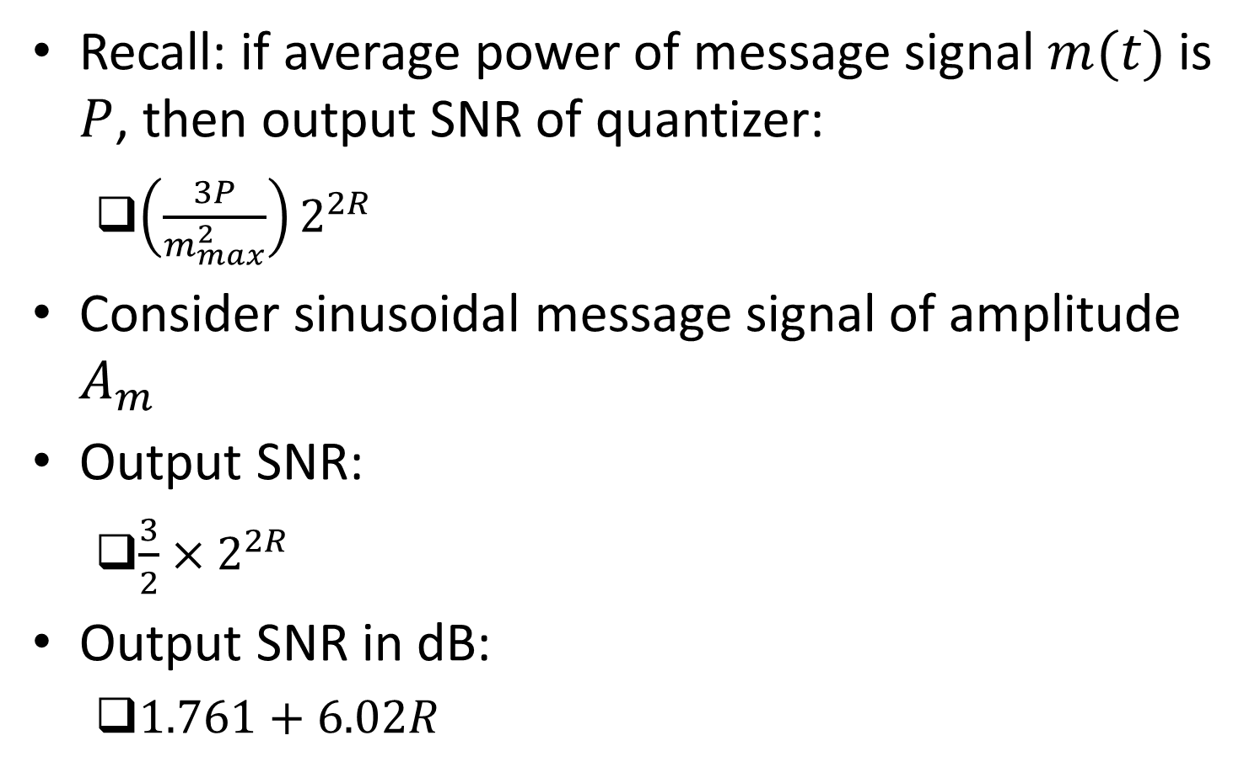
Example
Recall: if average power of message signal $m(t)$ is $P$, then output SNR of quantizer:
$\left(\frac{3P}{m_{max}^{2}}\right)2^{2R}$
Consider sinusoidal message signal of amplitude $A_{m}$
Output SNR:
$\frac{3}{2}×2^{2R}$
Output SNR in dB:
$1.761+6.02R$

Slide 18
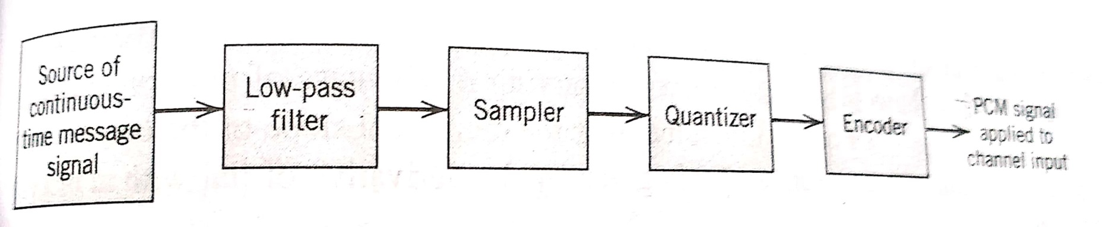
Pulse-Code Modulation (PCM)
Message signal sampled and each sample is quantized and represented using a set of bits
Fig. shows transmitter of PCM system
Low-pass filter used to:
prevent aliasing
Sampling (e.g., PAM) used with a sampling rate greater than Nyquist rate
Quantization may be:
uniform or
non-uniform (discussed later)
Encoding used to:
convert the sequence of quantized values to a form that is suitable for transmission over communication channel
Ref: “Communication Systems” by Haykin and Moher, 5th ed

Slide 19
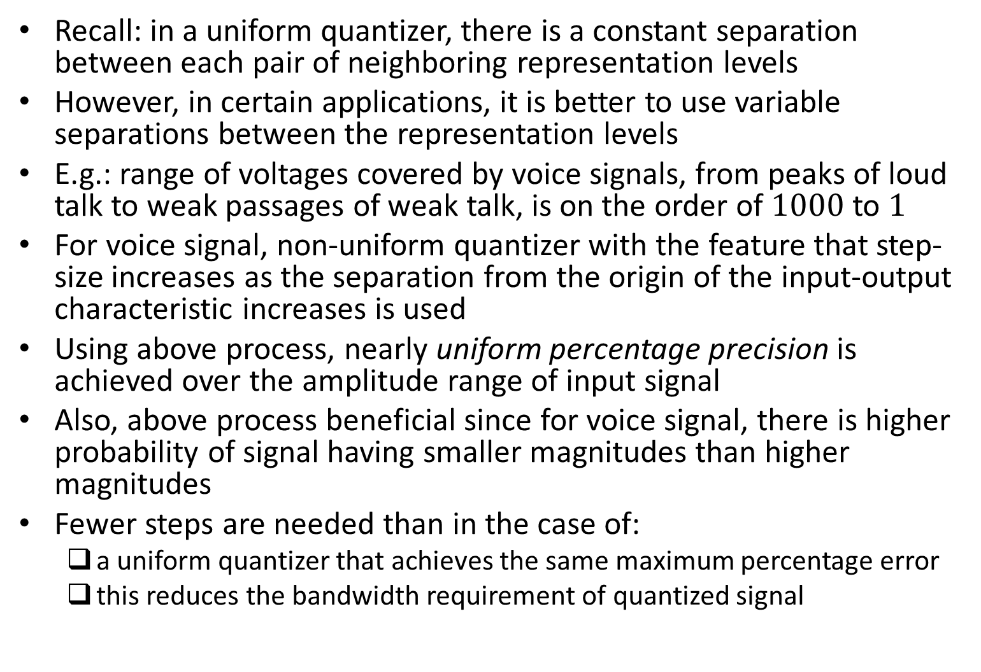
Non-Uniform Quantization
Recall: in a uniform quantizer, there is a constant separation between each pair of neighboring representation levels
However, in certain applications, it is better to use variable separations between the representation levels
E.g.: range of voltages covered by voice signals, from peaks of loud talk to weak passages of weak talk, is on the order of $1000$ to $1$
For voice signal, non-uniform quantizer with the feature that step-size increases as the separation from the origin of the input-output characteristic increases is used
Using above process, nearly uniform percentage precision is achieved over the amplitude range of input signal
Also, above process beneficial since for voice signal, there is higher probability of signal having smaller magnitudes than higher magnitudes
Fewer steps are needed than in the case of:
a uniform quantizer that achieves the same maximum percentage error
this reduces the bandwidth requirement of quantized signal

Slide 20
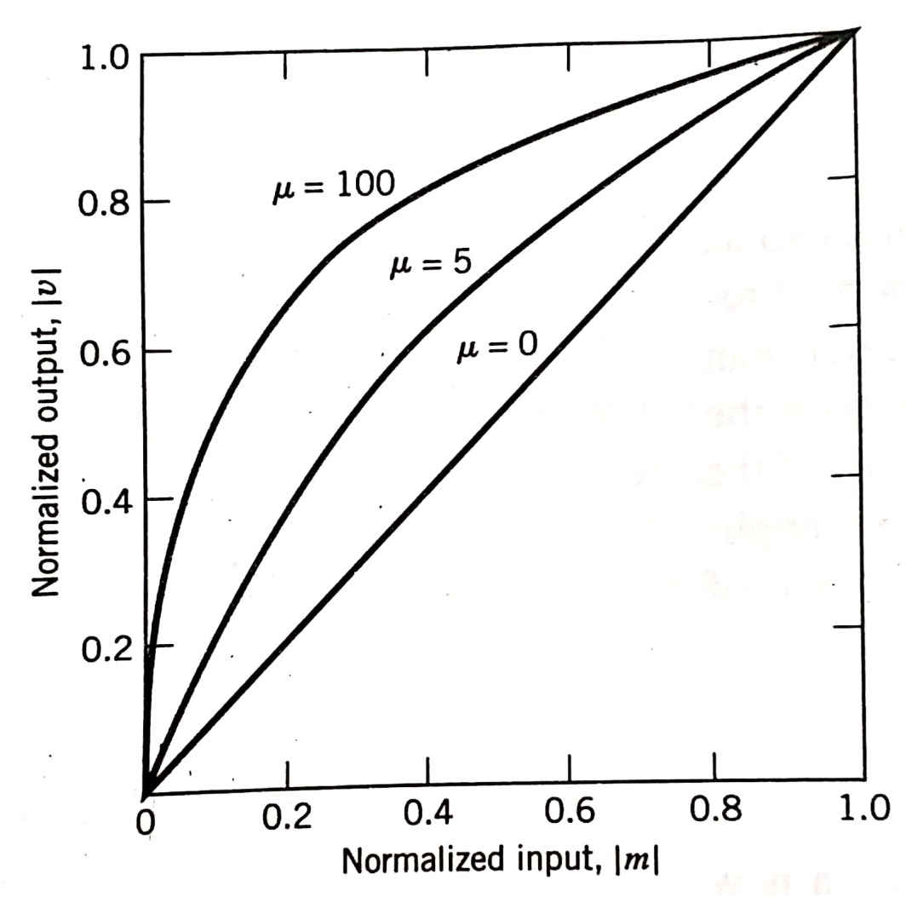

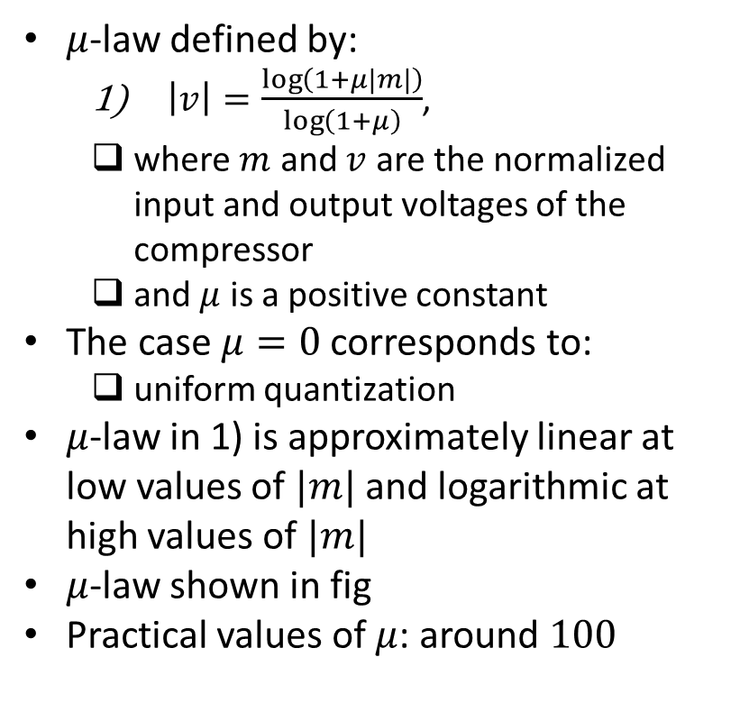
Compander
Use of a non-uniform quantizer equivalent to:
passing the input sample through a compressor and
applying the compressed sample to a uniform quantizer
Examples of compression laws that are widely used in practice:
$μ$-law
$A$-law
$μ$-law defined by:
$\left|v\right|=\frac{\log\left(1+μ|m|\right)}{\log\left(1+μ\right)}$,
where $m$ and $v$ are the normalized input and output voltages of the compressor
and $μ$ is a positive constant
The case $μ=0$ corresponds to:
uniform quantization
$μ$-law in 1) is approximately linear at low values of $|m|$ and logarithmic at high values of $|m|$
$μ$-law shown in fig
Practical values of $μ$: around $100$
Ref: “Communication Systems” by Haykin and Moher, 5th ed

Slide 21
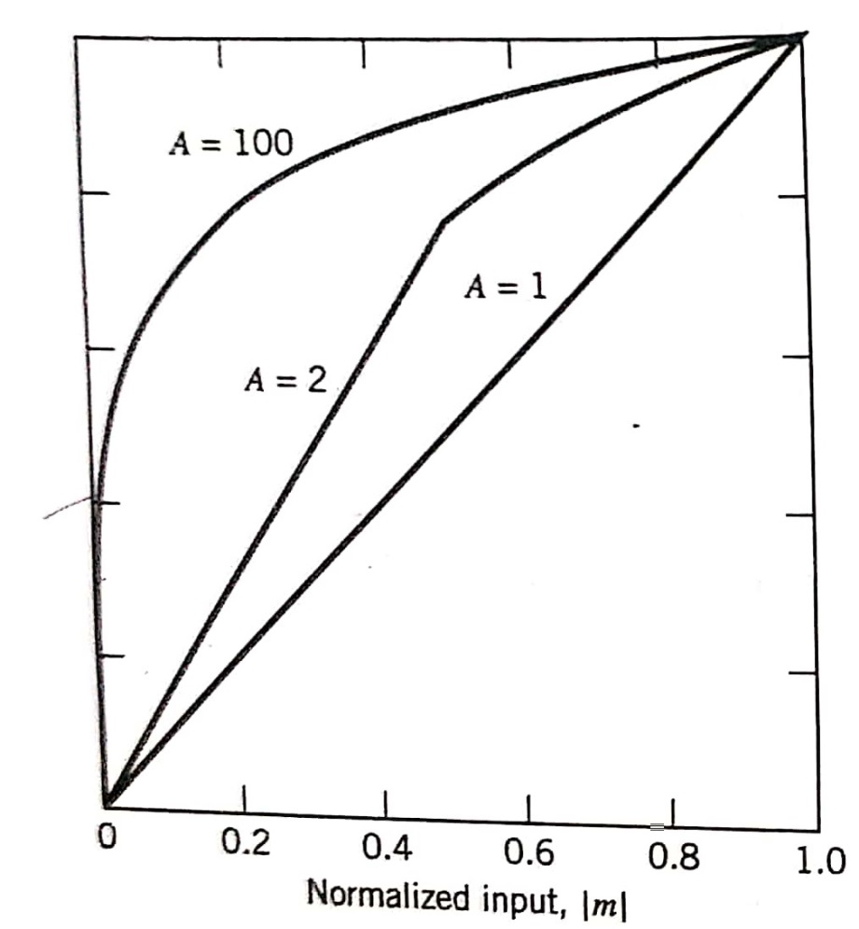
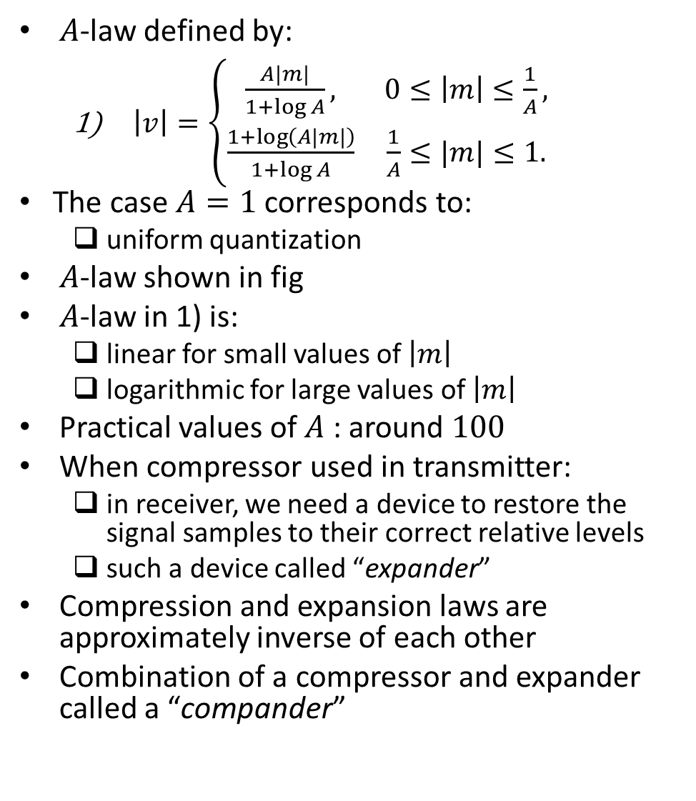
Compander (contd.)
$A$-law defined by:
$\left|v\right|=\left\{\begin{matrix}\frac{A|m|}{1+\log{A}}, & 0≤\left|m\right|≤\frac{1}{A}, \\ \frac{1+\log\left(A|m|\right)}{1+\log{A}} & \frac{1}{A}≤|m|≤1.\end{matrix}\right.$
The case $A=1$ corresponds to:
uniform quantization
$A$-law shown in fig
$A$-law in 1) is:
linear for small values of $\left|m\right|$
logarithmic for large values of $\left|m\right|$
Practical values of $A$ : around $100$
When compressor used in transmitter:
in receiver, we need a device to restore the signal samples to their correct relative levels
such a device called “expander”
Compression and expansion laws are approximately inverse of each other
Combination of a compressor and expander called a “compander”
Ref: “Communication Systems” by Haykin and Moher, 5th ed

Slide 22
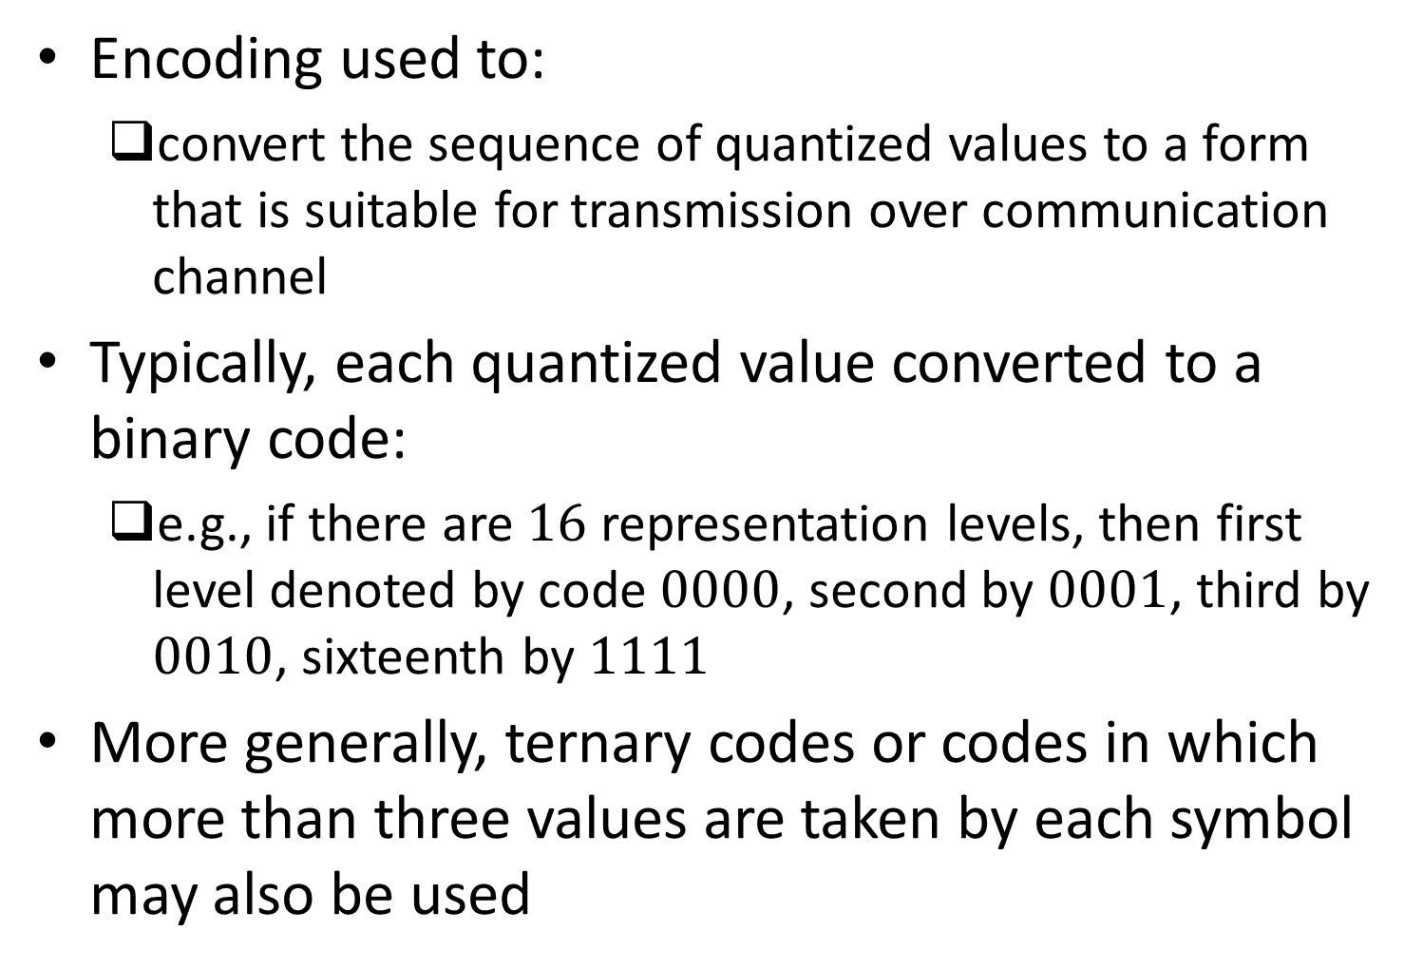
Encoding
Encoding used to:
convert the sequence of quantized values to a form that is suitable for transmission over communication channel
Typically, each quantized value converted to a binary code:
e.g., if there are $16$ representation levels, then first level denoted by code $0000$, second by $0001$, third by $0010$, sixteenth by $1111$
More generally, ternary codes or codes in which more than three values are taken by each symbol may also be used

Slide 23
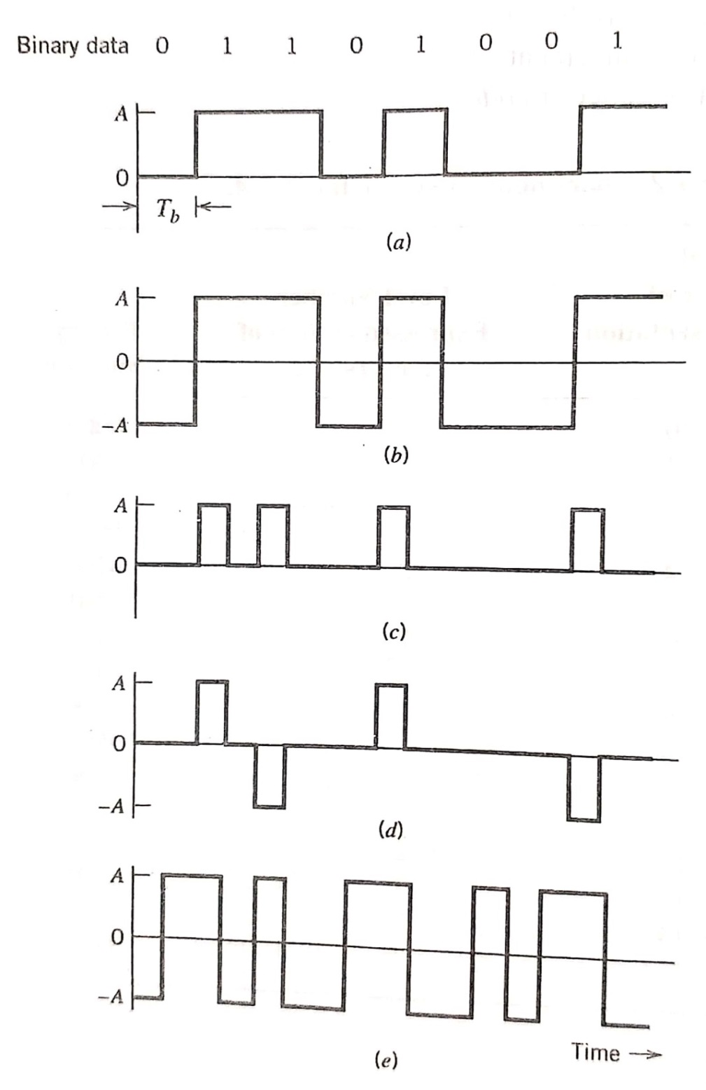
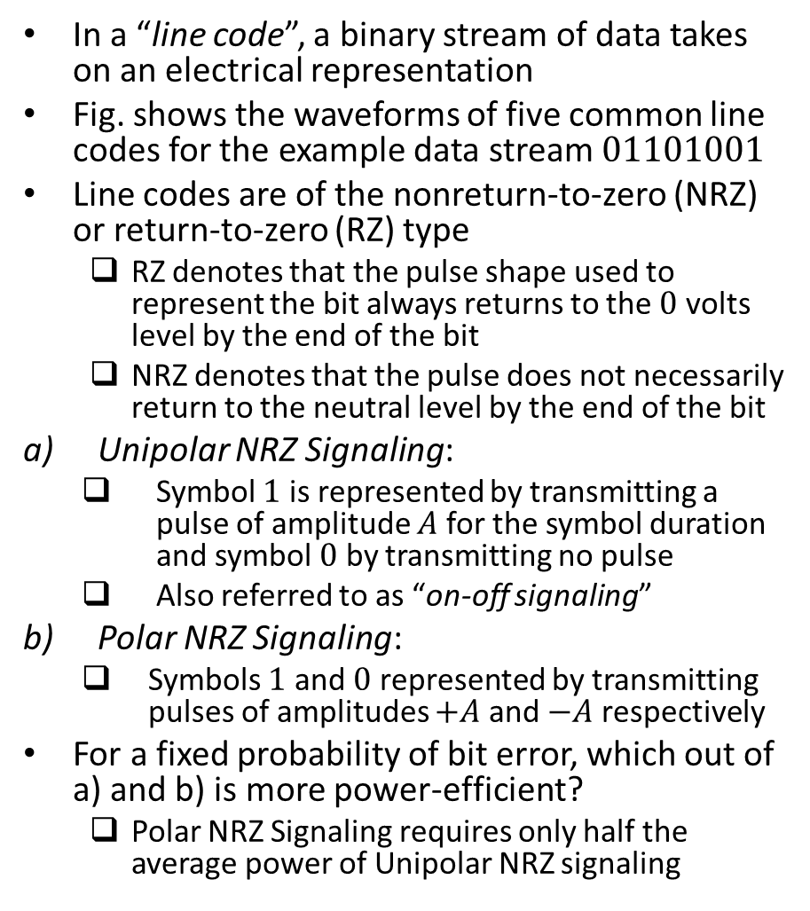
Line Codes
In a “line code”, a binary stream of data takes on an electrical representation
Fig. shows the waveforms of five common line codes for the example data stream $01101001$
Line codes are of the nonreturn-to-zero (NRZ) or return-to-zero (RZ) type
RZ denotes that the pulse shape used to represent the bit always returns to the $0$ volts level by the end of the bit
NRZ denotes that the pulse does not necessarily return to the neutral level by the end of the bit
Unipolar NRZ Signaling:
Symbol $1$ is represented by transmitting a pulse of amplitude $A$ for the symbol duration and symbol $0$ by transmitting no pulse
Also referred to as “on-off signaling”
Polar NRZ Signaling:
Symbols $1$ and $0$ represented by transmitting pulses of amplitudes $+A$ and $−A$ respectively
For a fixed probability of bit error, which out of a) and b) is more power-efficient?
Polar NRZ Signaling requires only half the average power of Unipolar NRZ signaling
Ref: “Communication Systems” by Haykin and Moher, 5th ed

Slide 24
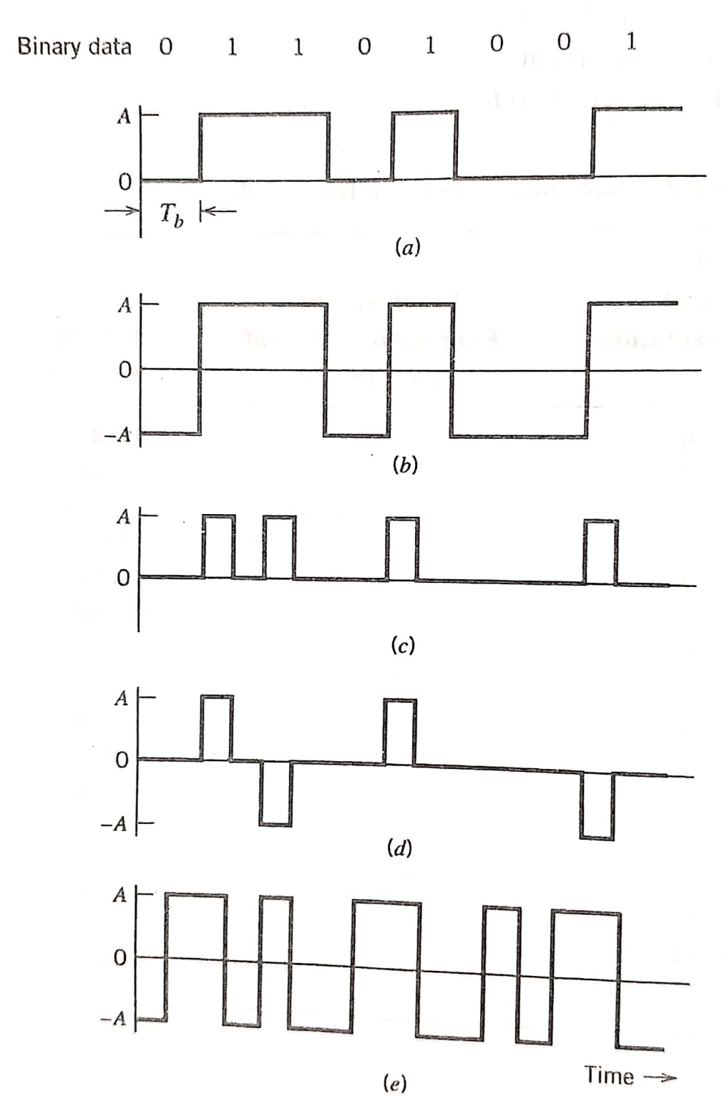
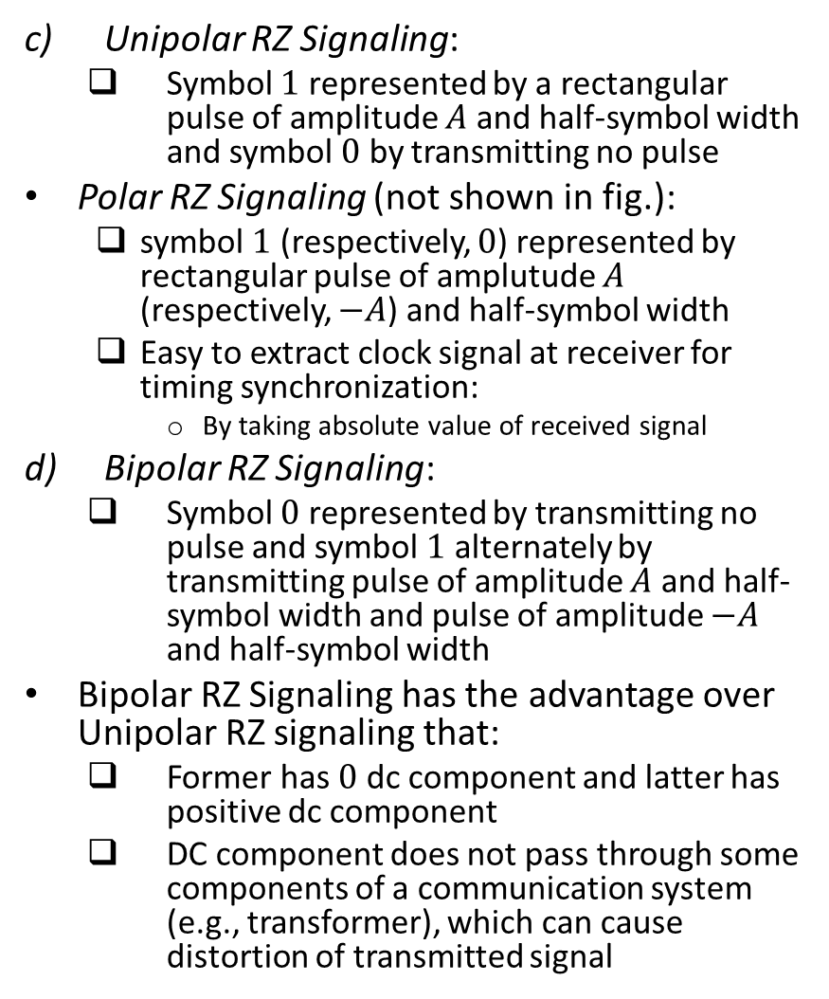
Line Codes (contd.)
Unipolar RZ Signaling:
Symbol $1$ represented by a rectangular pulse of amplitude $A$ and half-symbol width and symbol $0$ by transmitting no pulse
Polar RZ Signaling (not shown in fig.):
symbol $1$ (respectively, $0$) represented by rectangular pulse of amplutude $A$ (respectively, $−A$) and half-symbol width
Easy to extract clock signal at receiver for timing synchronization:
By taking absolute value of received signal
Bipolar RZ Signaling:
Symbol $0$ represented by transmitting no pulse and symbol $1$ alternately by transmitting pulse of amplitude $A$ and half-symbol width and pulse of amplitude $−A$ and half-symbol width
Bipolar RZ Signaling has the advantage over Unipolar RZ signaling that:
Former has $0$ dc component and latter has positive dc component
DC component does not pass through some components of a communication system (e.g., transformer), which can cause distortion of transmitted signal
Ref: “Communication Systems” by Haykin and Moher, 5th ed

Slide 25
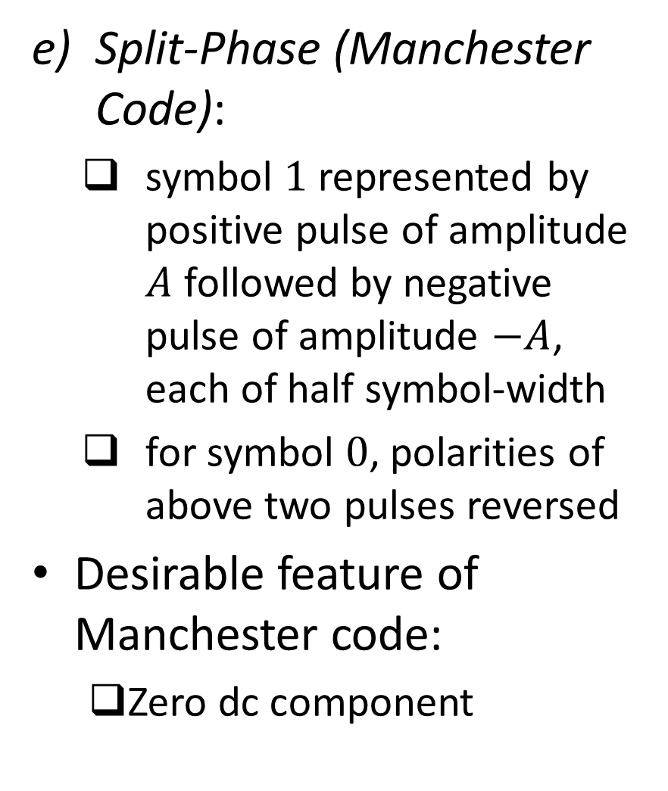
Line Codes (contd.)
Split-Phase (Manchester Code):
symbol $1$ represented by positive pulse of amplitude $A$ followed by negative pulse of amplitude $−A$, each of half symbol-width
for symbol $0$, polarities of above two pulses reversed
Desirable feature of Manchester code:
Zero dc component
Ref: “Communication Systems” by Haykin and Moher, 5th ed

Slide 26
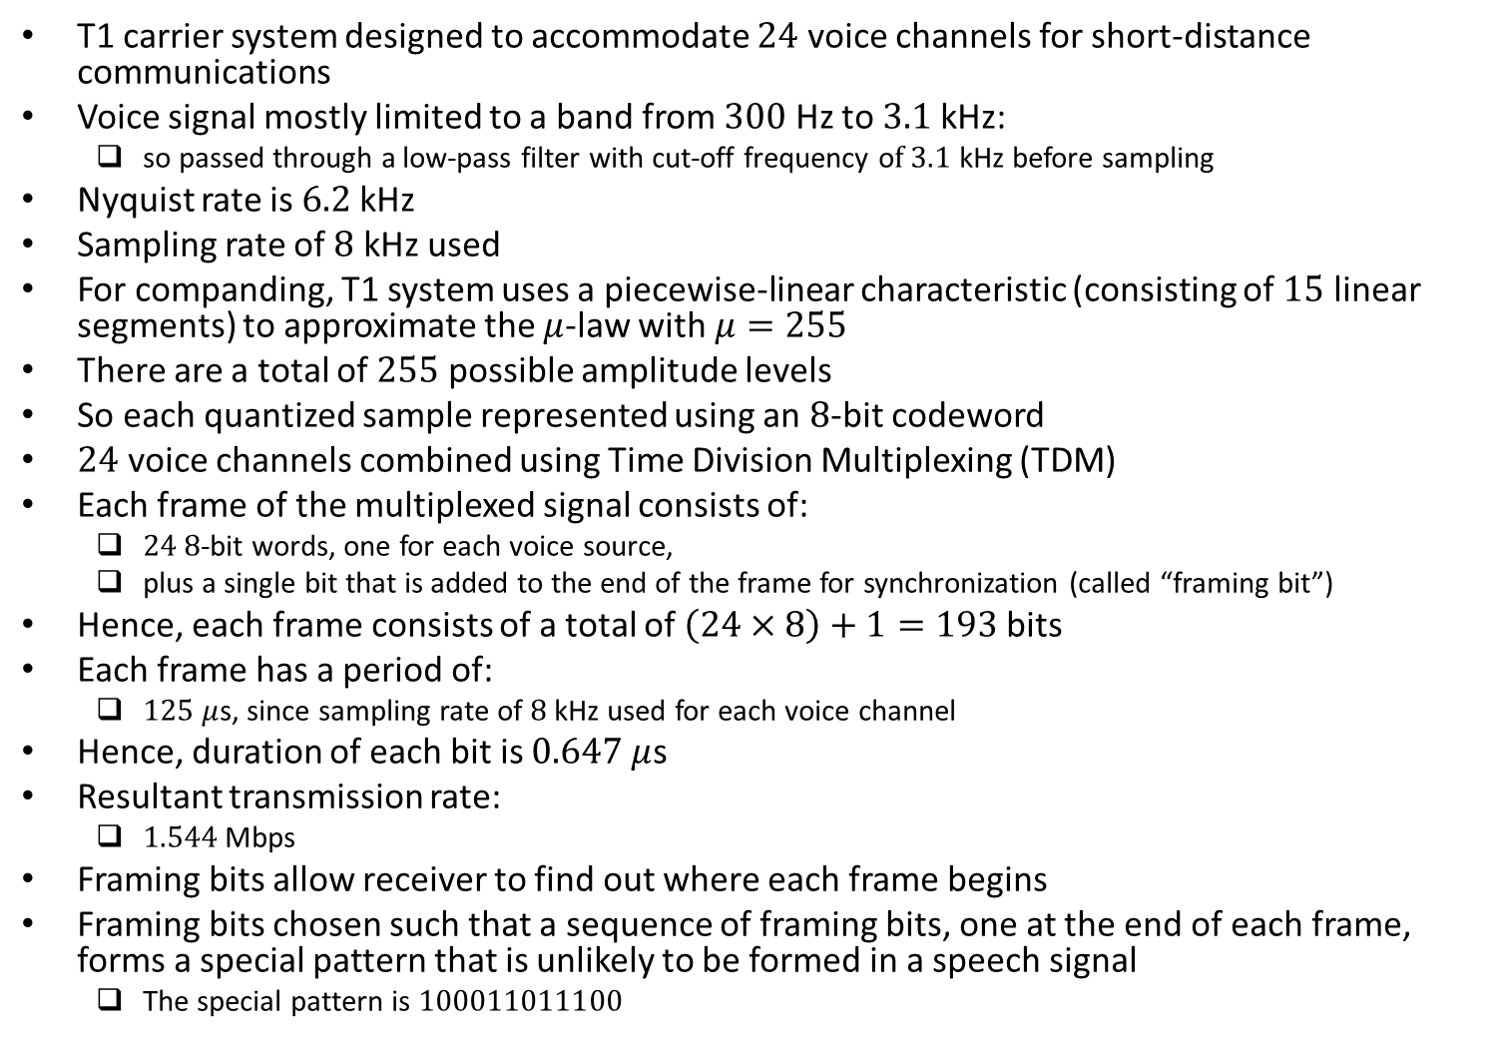
Example: T1 System
T1 carrier system designed to accommodate $24$ voice channels for short-distance communications
Voice signal mostly limited to a band from $300$ Hz to $3.1$ kHz:
so passed through a low-pass filter with cut-off frequency o$f 3.1$ kHz before sampling
Nyquist rate is $6.2$ kHz
Sampling rate of $8$ kHz used
For companding, T1 system uses a piecewise-linear characteristic (consisting of $15$ linear segments) to approximate the $μ$-law with $μ=255$
There are a total of $255$ possible amplitude levels
So each quantized sample represented using an $8$-bit codeword
$24$ voice channels combined using Time Division Multiplexing (TDM)
Each frame of the multiplexed signal consists of:
$24$ $8$-bit words, one for each voice source,
plus a single bit that is added to the end of the frame for synchronization (called “framing bit”)
Hence, each frame consists of a total of $\left(24×8\right)+1=193$ bits
Each frame has a period of:
$125$ $μ$s, since sampling rate of $8$ kHz used for each voice channel
Hence, duration of each bit is $0.647$ $μ$s
Resultant transmission rate:
$1.544$ Mbps
Framing bits allow receiver to find out where each frame begins
Framing bits chosen such that a sequence of framing bits, one at the end of each frame, forms a special pattern that is unlikely to be formed in a speech signal
The special pattern is $100011011100$

Slide 27
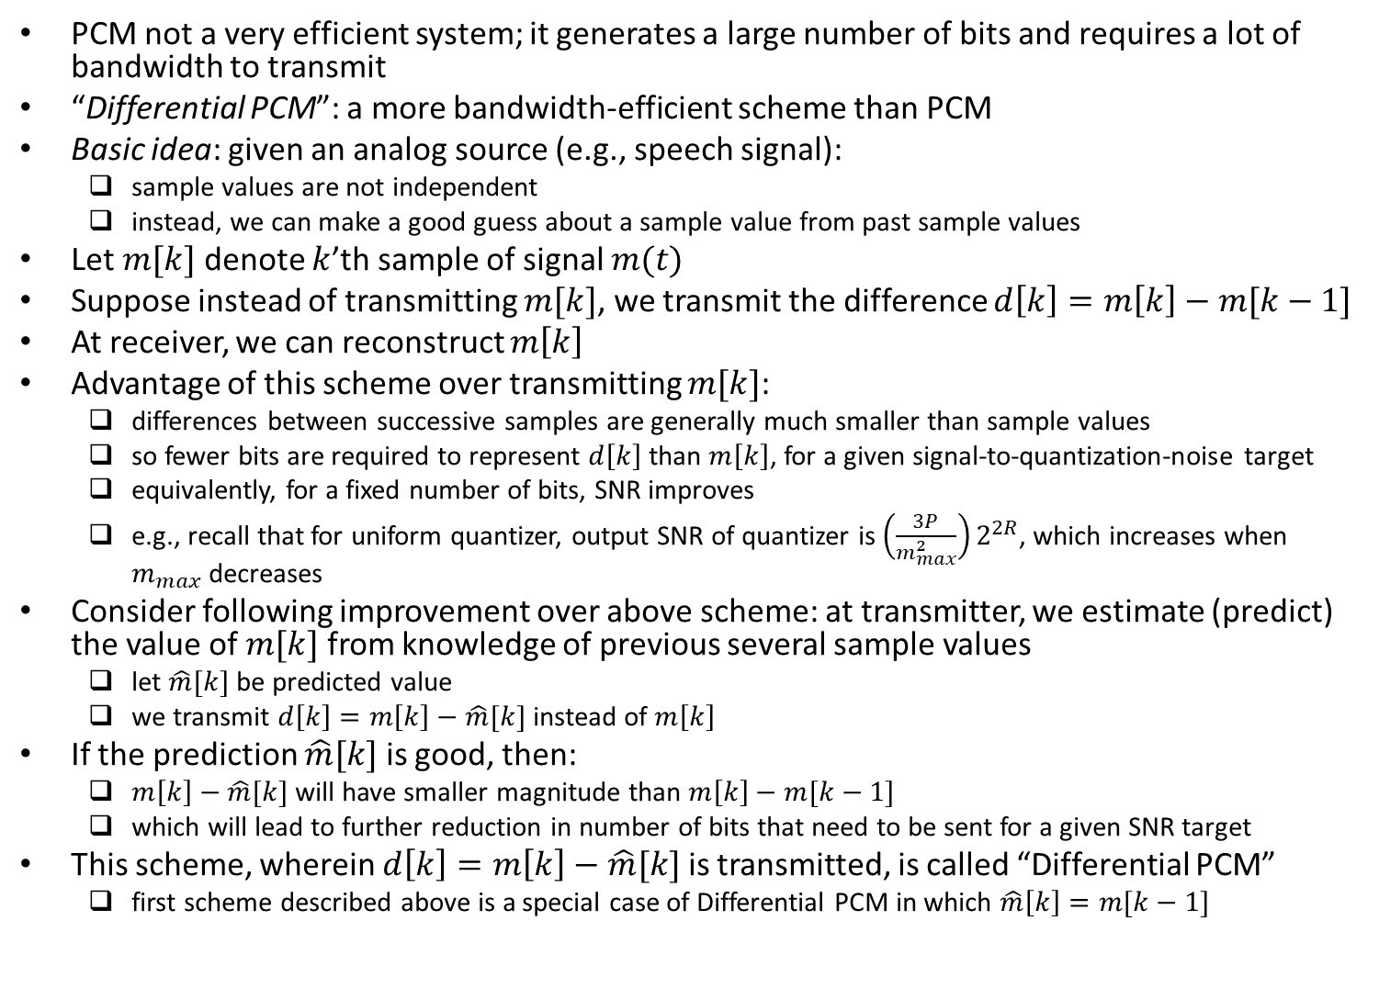
Differential PCM
PCM not a very efficient system; it generates a large number of bits and requires a lot of bandwidth to transmit
“Differential PCM”: a more bandwidth-efficient scheme than PCM
Basic idea: given an analog source (e.g., speech signal):
sample values are not independent
instead, we can make a good guess about a sample value from past sample values
Let $m[k]$ denote $k$’th sample of signal $m(t)$
Suppose instead of transmitting $m[k]$, we transmit the difference $d\left[k\right]=m\left[k\right]−m[k−1]$
At receiver, we can reconstruct $m\left[k\right]$
Advantage of this scheme over transmitting $m[k]$:
differences between successive samples are generally much smaller than sample values
so fewer bits are required to represent $d\left[k\right]$ than $m\left[k\right]$, for a given signal-to-quantization-noise target
equivalently, for a fixed number of bits, SNR improves
e.g., recall that for uniform quantizer, output SNR of quantizer is $\left(\frac{3P}{m_{max}^{2}}\right)2^{2R}$, which increases when $m_{max}$ decreases
Consider following improvement over above scheme: at transmitter, we estimate (predict) the value of $m[k]$ from knowledge of previous several sample values
let $\hat{m}[k]$ be predicted value
we transmit $d\left[k\right]=m\left[k\right]−\hat{m}[k]$ instead of $m\left[k\right]$
If the prediction $\hat{m}[k]$ is good, then:
$m\left[k\right]−\hat{m}[k]$ will have smaller magnitude than $m\left[k\right]−m[k−1]$
which will lead to further reduction in number of bits that need to be sent for a given SNR target
This scheme, wherein $d\left[k\right]=m\left[k\right]−\hat{m}[k]$ is transmitted, is called “Differential PCM”
first scheme described above is a special case of Differential PCM in which $\hat{m}\left[k\right]=m[k−1]$

Slide 28
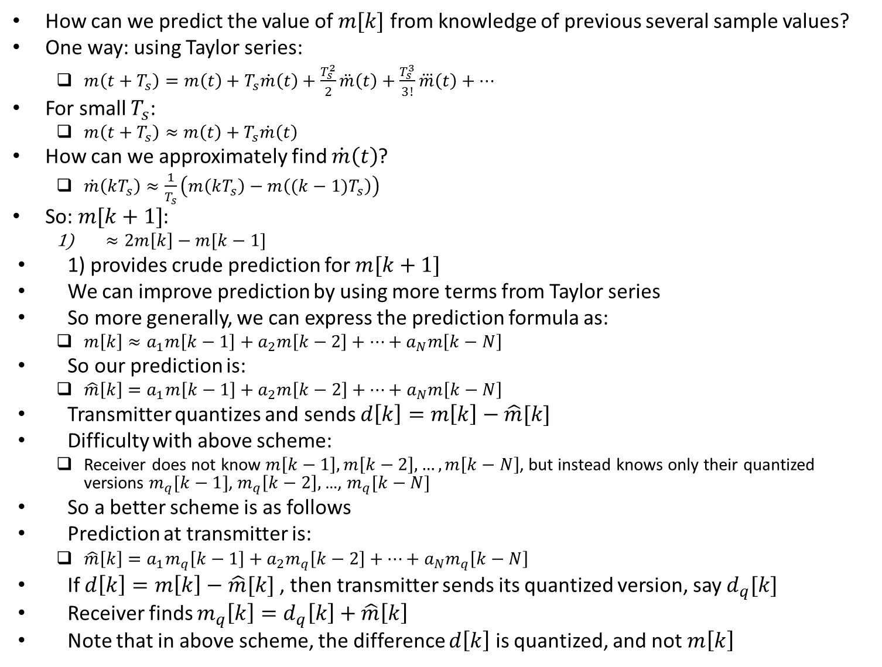
Differential PCM (contd.)
How can we predict the value of $m[k]$ from knowledge of previous several sample values?
One way: using Taylor series:
$m\left(t+T_{s}\right)=m\left(t\right)+T_{s}\dot{m}\left(t\right)+\frac{T_{s}^{2}}{2}\ddot{m}\left(t\right)+\frac{T_{s}^{3}}{3!}\overset{⃛}{m}\left(t\right)+…$
For small $T_{s}$:
$m\left(t+T_{s}\right)≈m\left(t\right)+T_{s}\dot{m}\left(t\right)$
How can we approximately find $\dot{m}\left(t\right)$?
$\dot{m}\left(kT_{s}\right)≈\frac{1}{T_{s}}\left(m\left(kT_{s}\right)−m\left((k−1)T_{s}\right)\right)$
So: $m[k+1]$:
$≈2m\left[k\right]−m[k−1]$
1) provides crude prediction for $m[k+1]$
We can improve prediction by using more terms from Taylor series
So more generally, we can express the prediction formula as:
$m\left[k\right]≈a_{1}m\left[k−1\right]+a_{2}m\left[k−2\right]+…+a_{N}m\left[k−N\right]$
So our prediction is:
$\hat{m}\left[k\right]=a_{1}m\left[k−1\right]+a_{2}m\left[k−2\right]+…+a_{N}m\left[k−N\right]$
Transmitter quantizes and sends $d\left[k\right]=m\left[k\right]−\hat{m}[k]$
Difficulty with above scheme:
Receiver does not know $m\left[k−1\right],m\left[k−2\right],…,m\left[k−N\right]$, but instead knows only their quantized versions $m_{q}[k−1]$, $m_{q}\left[k−2\right],$ …, $m_{q}[k−N]$
So a better scheme is as follows
Prediction at transmitter is:
$\hat{m}\left[k\right]=a_{1}m_{q}\left[k−1\right]+a_{2}m_{q}\left[k−2\right]+…+a_{N}m_{q}\left[k−N\right]$
If $d\left[k\right]=m\left[k\right]−\hat{m}[k]$, then transmitter sends its quantized version, say $d_{q}[k]$
Receiver finds $m_{q}\left[k\right]=d_{q}\left[k\right]+\hat{m}\left[k\right]$
Note that in above scheme, the difference $d\left[k\right]$ is quantized, and not $m\left[k\right]$

Slide 29
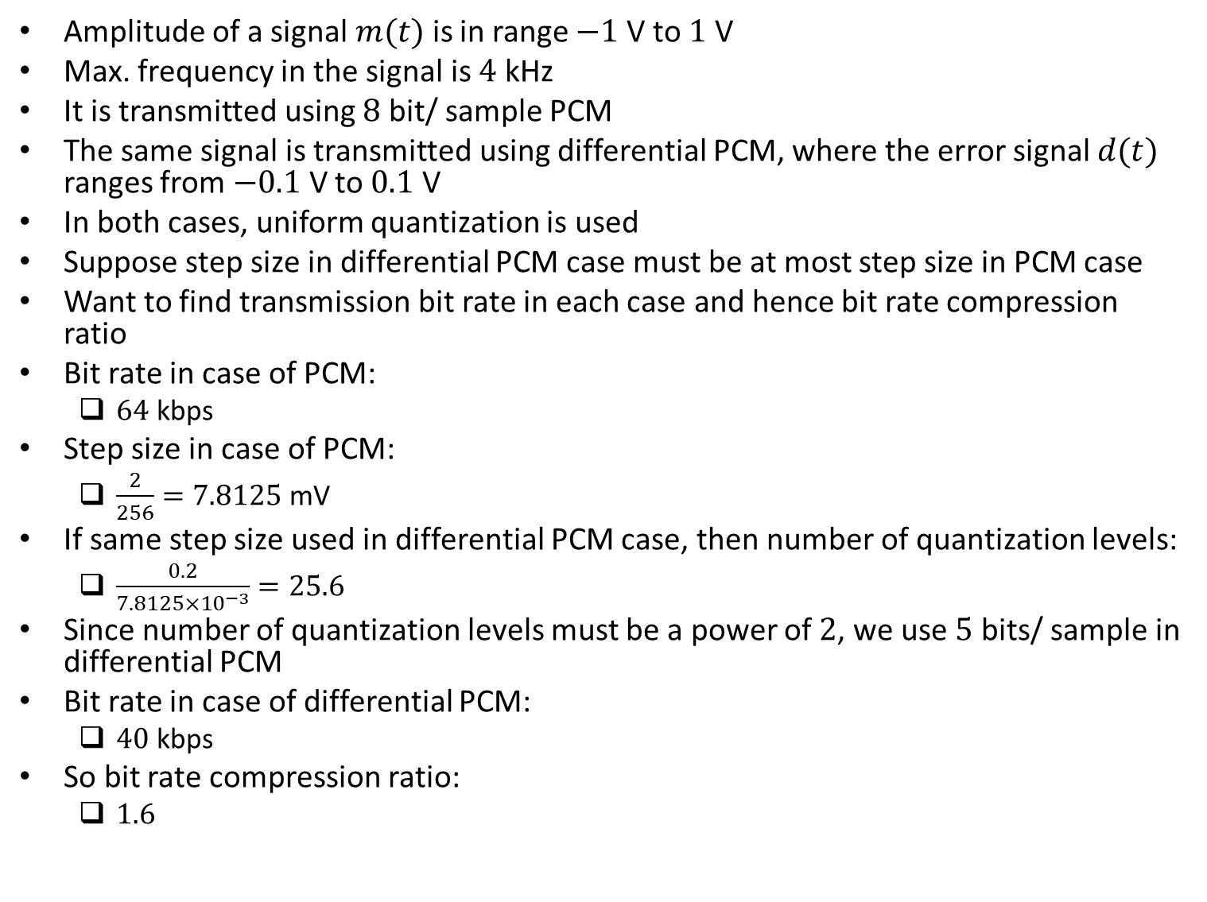
Example
Amplitude of a signal $m(t)$ is in range $−1$ V to $1$ V
Max. frequency in the signal is $4$ kHz
It is transmitted using $8$ bit/ sample PCM
The same signal is transmitted using differential PCM, where the error signal $d(t)$ ranges from $−0.1$ V to $0.1$ V
In both cases, uniform quantization is used
Suppose step size in differential PCM case must be at most step size in PCM case
Want to find transmission bit rate in each case and hence bit rate compression ratio
Bit rate in case of PCM:
$64$ kbps
Step size in case of PCM:
$\frac{2}{256}=7.8125$ mV
If same step size used in differential PCM case, then number of quantization levels:
$\frac{0.2}{7.8125×{10}^{−3}}=25.6$
Since number of quantization levels must be a power of $2$, we use $5$ bits/ sample in differential PCM
Bit rate in case of differential PCM:
$40$ kbps
So bit rate compression ratio:
$1.6$

Slide 30
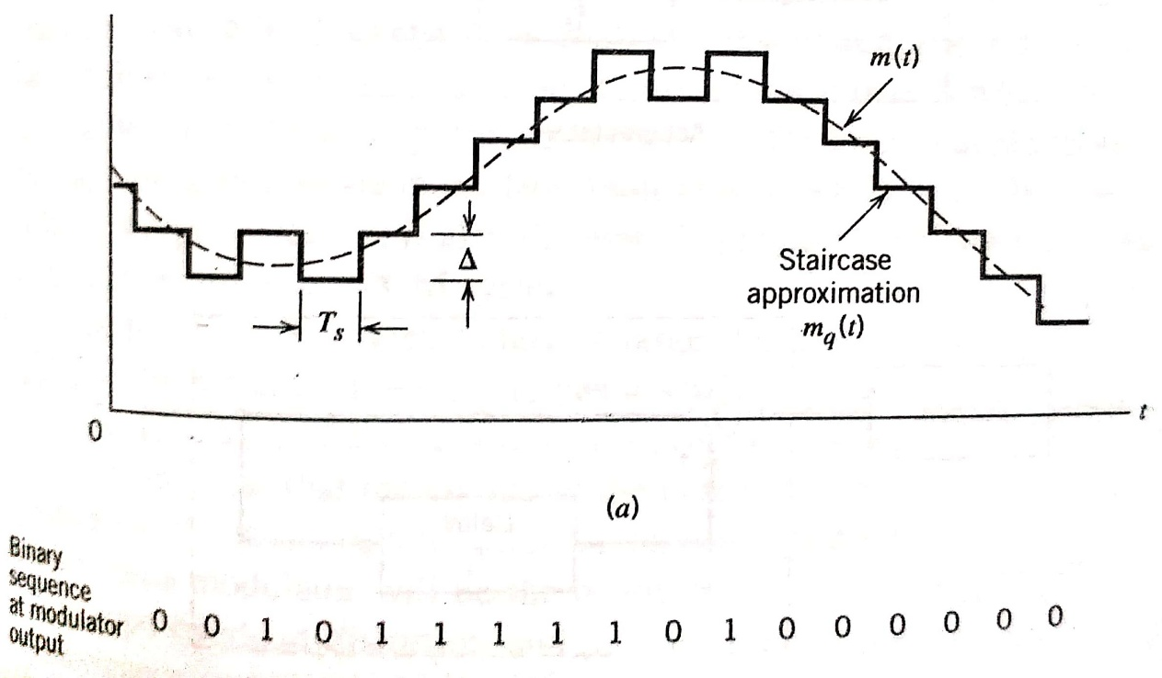
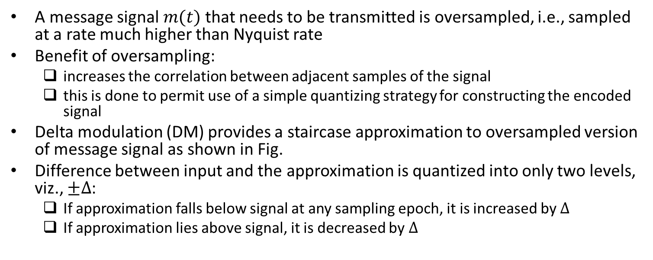
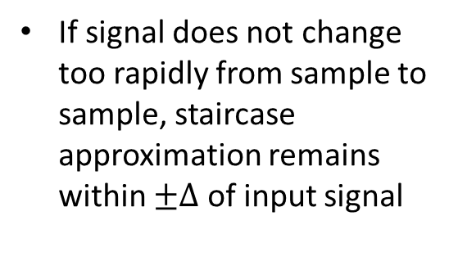
Delta Modulation
A message signal $m(t)$ that needs to be transmitted is oversampled, i.e., sampled at a rate much higher than Nyquist rate
Benefit of oversampling:
increases the correlation between adjacent samples of the signal
this is done to permit use of a simple quantizing strategy for constructing the encoded signal
Delta modulation (DM) provides a staircase approximation to oversampled version of message signal as shown in Fig.
Difference between input and the approximation is quantized into only two levels, viz., $±∆$:
If approximation falls below signal at any sampling epoch, it is increased by $∆$
If approximation lies above signal, it is decreased by $∆$
If signal does not change too rapidly from sample to sample, staircase approximation remains within $±∆$ of input signal
Ref: “Communication Systems” by Haykin and Moher, 5th ed

Slide 31
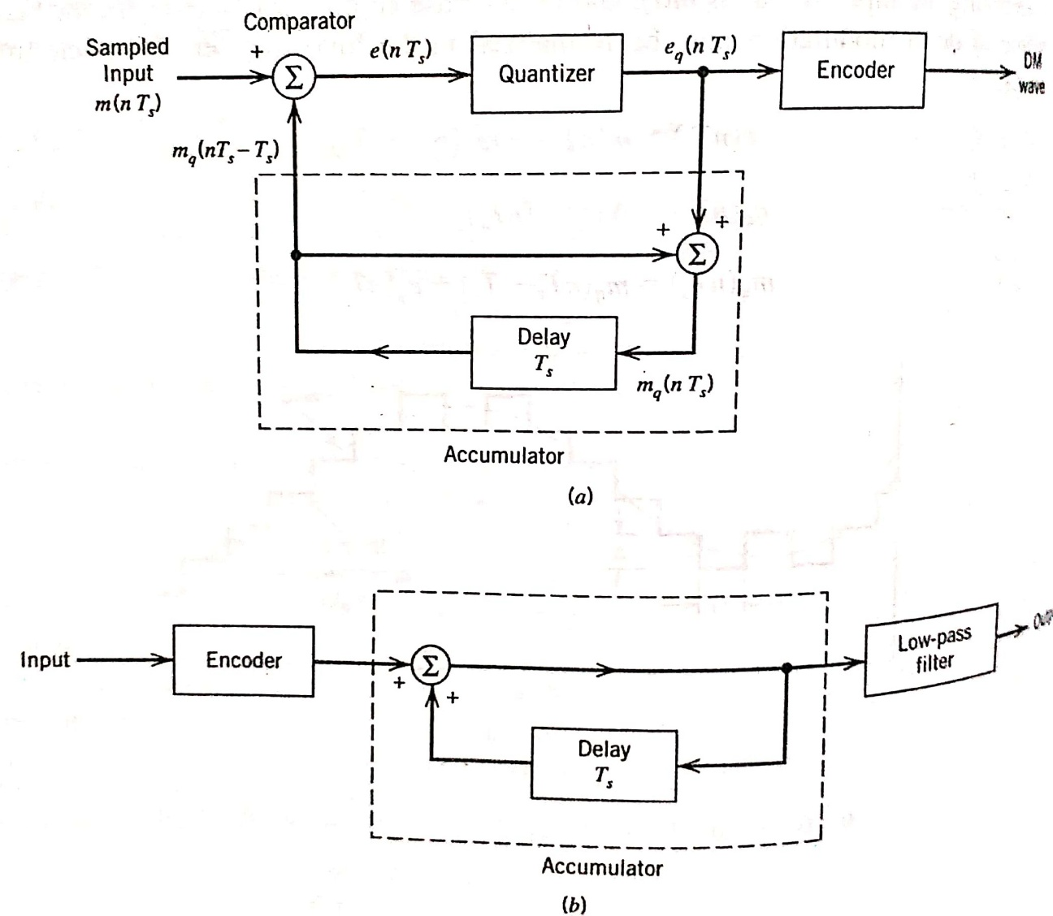
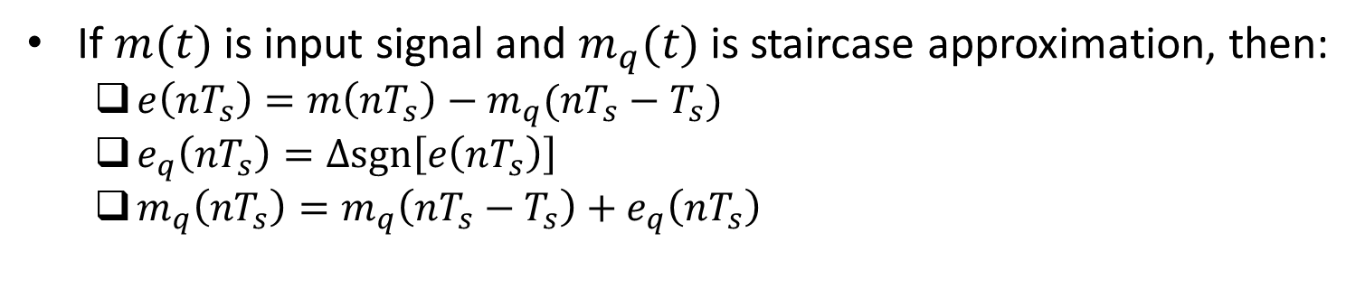
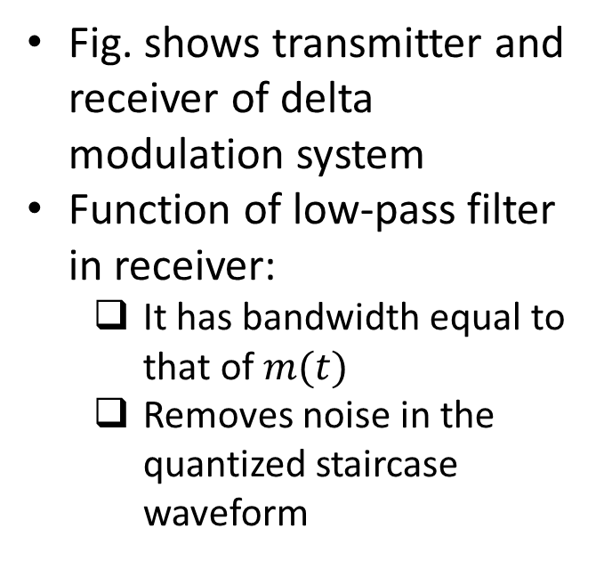
Delta Modulation (contd.)
If $m(t)$ is input signal and $m_{q}(t)$ is staircase approximation, then:
$e\left(nT_{s}\right)=m\left(nT_{s}\right)−m_{q}(nT_{s}−T_{s})$
$e_{q}\left(nT_{s}\right)=∆sgn\left[e\left(nT_{s}\right)\right]$
$m_{q}\left(nT_{s}\right)=m_{q}\left(nT_{s}−T_{s}\right)+e_{q}\left(nT_{s}\right)$
Fig. shows transmitter and receiver of delta modulation system
Function of low-pass filter in receiver:
It has bandwidth equal to that of $m(t)$
Removes noise in the quantized staircase waveform
Ref: “Communication Systems” by Haykin and Moher, 5th ed

Slide 32
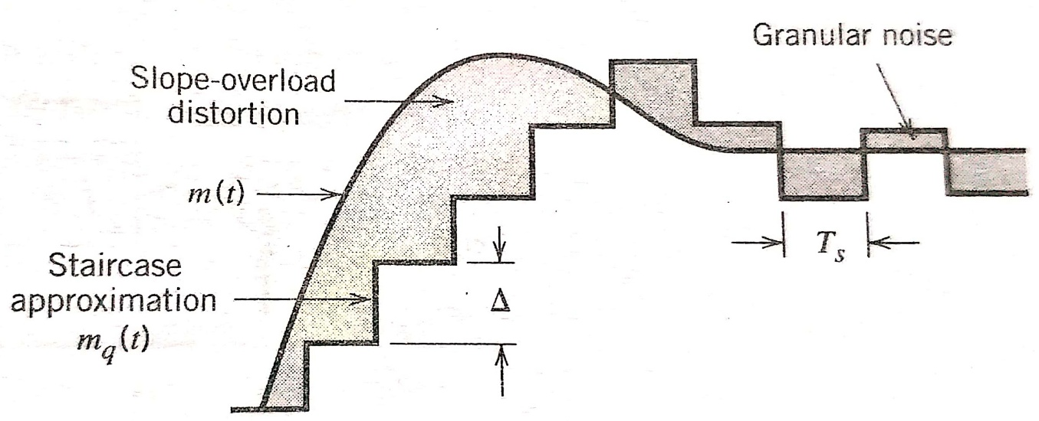
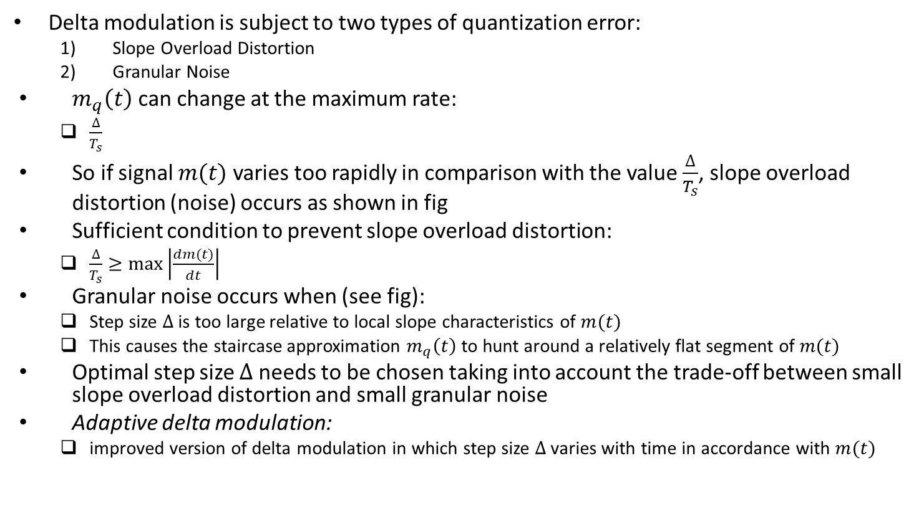
Delta Modulation (contd.)
Delta modulation is subject to two types of quantization error:
Slope Overload Distortion
Granular Noise
$m_{q}\left(t\right)$ can change at the maximum rate:
$\frac{∆}{T_{s}}$
So if signal $m(t)$ varies too rapidly in comparison with the value $\frac{∆}{T_{s}}$, slope overload distortion (noise) occurs as shown in fig
Sufficient condition to prevent slope overload distortion:
$\frac{∆}{T_{s}}≥max\left|\frac{dm(t)}{dt}\right|$
Granular noise occurs when (see fig):
Step size $∆$ is too large relative to local slope characteristics of $m(t)$
This causes the staircase approximation $m_{q}\left(t\right)$ to hunt around a relatively flat segment of $m(t)$
Optimal step size $∆$ needs to be chosen taking into account the trade-off between small slope overload distortion and small granular noise
Adaptive delta modulation:
improved version of delta modulation in which step size $∆$ varies with time in accordance with $m(t)$
Ref: “Communication Systems” by Haykin and Moher, 5th ed

Slide 33

Example
Delta modulation has smaller bandwidth requirement than PCM as illustrated in this example
For telephone applications, a typical PCM system uses $8$ kHz sampling rate and an $8$ bit representation of each sample
So bit rate:
$64$ kbps
Sampling rates for delta modulation range from $16$ to $32$ kHz depending on the desired voice quality
Corresponding bit rates:
$16$ to $32$ kbps, since delta modulation requires $1$ bit per sample
Bandwidth savings under delta modulation compared with PCM:
$50$ to $75\%$

